Slide 1
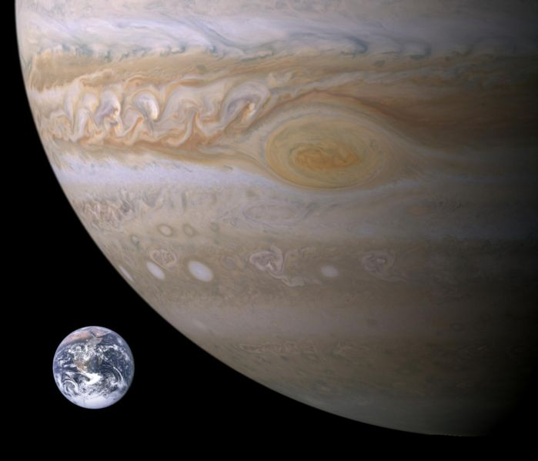
Unit V Lesson I: “Jupiter”
Astronomy
Notes:
Image shows Earth in size comparison with Jupiter. Both pictures are real. The Earth image was from Apollo 9 (1968) and Jupiter was photographed up-close by the Voyager spacecraft (1979). The “Great Red Spot” is about 2.5 times the size of the Earth in diameter and is analogous to a hurricane on Earth.

Slide 2
S.W.B.A.T.
Identify the physical characteristics of the planet Jupiter
Describe/understand/identify the processes that affect Jupiter’s moons
Discuss spacecraft missions to Jupiter
Notes:
“Students Will Be Able To…” - another way to state the lesson objectives.

Slide 3
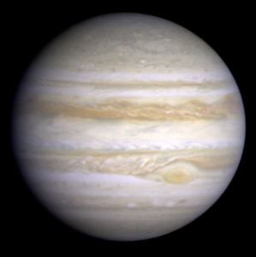
Physical Data
5th planet from the Sun; distance 5.2 AU
Largest of all the planets
71,500 km equatorial radius or about 11 Earths (in diameter)
1 Jupiter year equals 12 Earth years
Notes:
“AU” stands for Astronomical Units or the average distance between the Earth & Sun (93 million miles or about 150 million km). All of the other planets could fit inside Jupiter with much room to spare. Jupiter takes about 12 Earth years to orbit the Sun once. All of the outer planets take much longer to orbit the farther they are from the Sun.

Slide 4
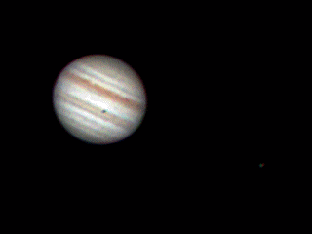
Physical Data
Spins once in about 10 hours (1 day = 9.925 hours) and is the fastest spinning planet in the solar system
Tilted about 3 degrees
Average cloud top temperature minus 270 degrees Fahrenheit
Notes:
One sidereal (star) day on Jupiter is exactly 9 hours and 56 minutes. Determining the length of a day on Jupiter was very difficult, because, unlike the terrestrial planets, it does not have surface features that scientists could use to determine its rotational speed. Scientist were finally able to use radio emissions from Jupiter’s magnetic field to calculate the planet’s rotational period and speed. While other parts of the planet rotate at different speeds (the atmosphere above the poles rotates about five minutes slower than the atmosphere at the equator), the speed as measured by the magnetosphere is used as the official rotational speed and period. The GIF file shows Jupiter as NASA’s Voyager I space probe approaches in 1979. Note at least two of Jupiter’s moons that are visible. Other spacecraft have visited Jupiter as a “gravity assist” to boost speed including the New Horizons mission currently on its way past Pluto (2015) onto another KPO (Kuiper Belt Object) flyby in 2019.

Slide 5
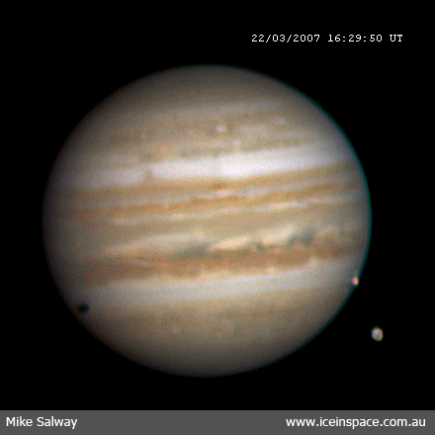
Physical Data
Four major moons; 63 total natural satellites
Has 2.4 times the mass of all the other planets combined
Known as a “failed star”
Produces more heat than it receives from the Sun
Notes:
Three moons can be seen in this gif file from the Galileo spacecraft on approach to orbit Jupiter. The other 59 moons are most likely captured asteroids. Theoretical calculations indicate (and direct observations corroborate) that the fusion-threshold limit lies somewhere around 0.08 solar masses; a near-star below this limit is called a brown dwarf. By contrast, Jupiter, the largest planet in our solar system, is only 0.001 masses solar. This makes the smallest possible stars roughly 80 times more massive than Jupiter; that is, Jupiter would need something like 80 times more mass to become even one of the smallest and feeblest red dwarf star. * FAQ: “if Jupiter became a star how would that affect Earth?” Earth would receive the light from a red dwarf/Jupiter star but not the heat (too small) – there would be almost no night on Earth. (See the video clip at the end of the presentation to demonstrate what a red dwarf/Jupiter star would look like!)

Slide 6
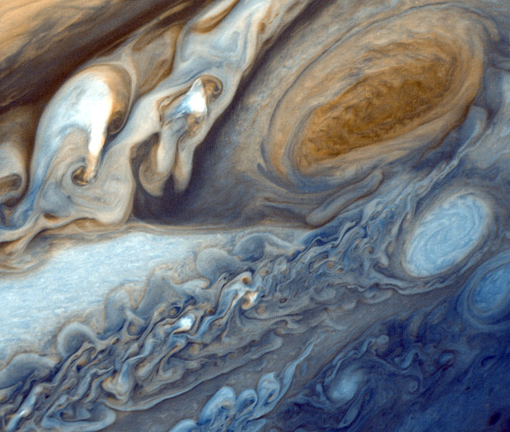
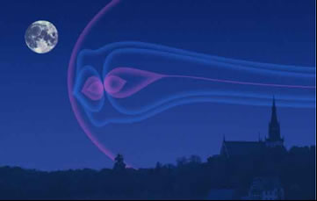
Physical Data
“Great Red Spot” cloud-top hurricane-like feature (visible in small telescopes)
Strongest magnetic field extending past Saturn’s orbit
Has a ring system
Video (2:41) “Weather on Jupiter”
Notes:
Top image is from Voyager I and is a close-up of the Great Red Spot. Bottom image shows Jupiter's magnetosphere as it would appear from Earth - in this artist's depiction - larger than the Moon in the sky. The magnetosphere of Jupiter is the cavity created in the solar wind by the planet's magnetic field. Extending up to seven million kilometers in the Sun's direction and almost to the orbit of Saturn in the opposite direction, Jupiter's magnetosphere is the largest and most powerful of any planetary magnetosphere in the Solar System, and by volume the largest known continuous structure in the Solar System after the Sun’s heliosphere.

Slide 7
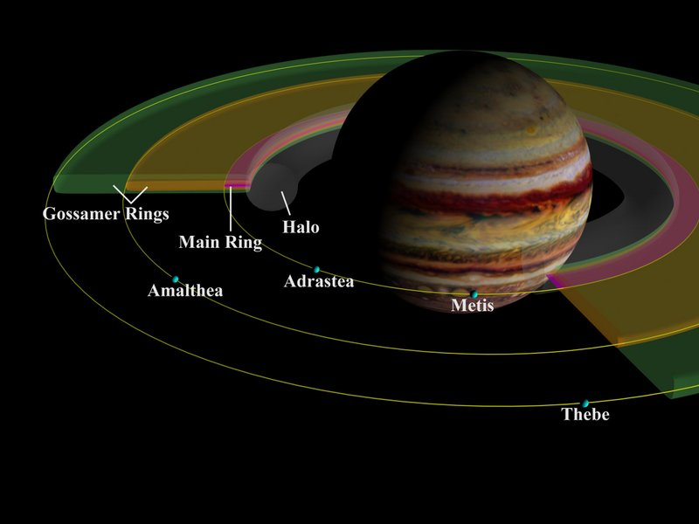
Jupiter’s Rings & Small Moons
Notes:
Jupiter's ring was discovered by Voyager 1 in a single image that was targeted specifically to search for a faint ring system. Subsequently, Voyager 2 was reprogrammed to take a more complete set of images. The ring is now known to be composed of three major components. The "Main" ring is about 7,000 km wide and has an abrupt outer boundary 129,130 km from the center of the planet. The main ring encompasses the orbits of two small moons, Adrastea and Metis, which may act as the source for the dust that makes up most of the ring. At its inner edge the main ring merges gradually into the "Halo." The halo is a broad, faint torus of material about 20,000 km thick and extending halfway from the main ring down to the planet's cloudtops. Just outside the main ring is the broad and exceedingly faint "Gossamer" ring, which extends out beyond the orbit of the moon Amalthea. It is probably composed of dust particles less than 10 microns in diameter -- about the size of cigarette smoke particles.

Slide 8
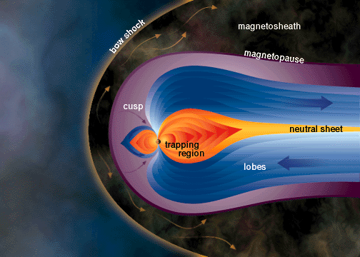
Jupiter’s Magnetic Field
Notes:
Jupiter's rings and moons exist within an intense radiation belt of electrons and ions trapped in the planet's magnetic field. These particles and fields comprise the Jovian magnetosphere or magnetic environment, which extends 3 to 7 million km (1.9 to 4.3 million miles) toward the sun, and stretches in a windsock shape at least as far as Saturn's orbit -- a distance of 750 million km (466 million miles).

Slide 9
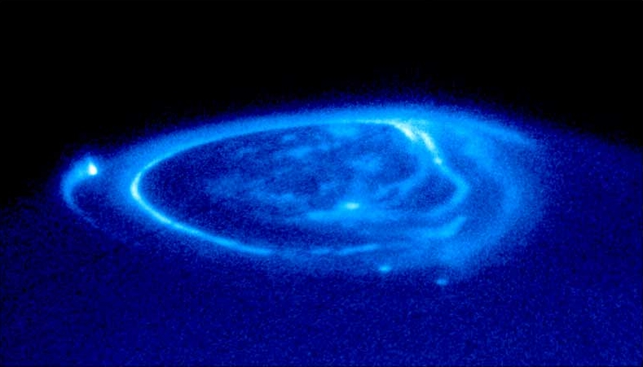
Jupiter’s Northern Lights – Hubble Space Telescope
Notes:
Jupiter's aurora is a very powerful source of energy. It produces much more power (about a million Megawatts) than the Earth's aurora (about 1000 Megawatts). For comparison, a large city uses about 10,000 Megawatts. This energy can sometimes have a significant impact on the atmosphere. Unlike the Earth, the Jovian aurora is thought to come from two places, from the moon Io, and from currents carrying particles from somewhere deeper in Jupiter's magneto tail.

Slide 10
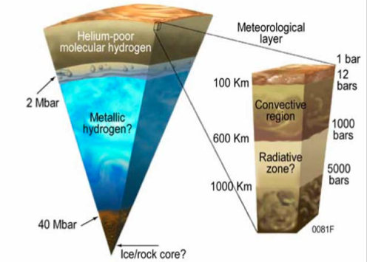
Composition & Structure
93% hydrogen; 7% helium with trace gases (methane, water vapor, ammonia etc.)
Temperatures increase below the cloud tops towards the core
Notes:
The Giant planets do not have the same layered structure that the terrestrial planets do. Their evolution was quite different than that of the terrestrial planets, and they have less solid material.

Slide 11
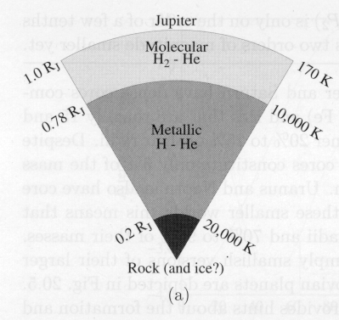
Composition & Structure
May contain a rocky core at least 12 times Earth’s mass
Core surrounded by an ocean of liquid metallic hydrogen
Gaseous hydrogen surrounds the liquid
Notes:
Jupiter's interior composition is primarily that of simple molecules such as hydrogen and helium, which are liquids under the high pressure environments found in the interiors of the outer planets, and not solids. Details about Jupiter's core remain a challenge to find. Scientists think that the dense central core may be surrounded by a layer of metallic hydrogen, with another layer of molecular hydrogen on top.

Slide 12
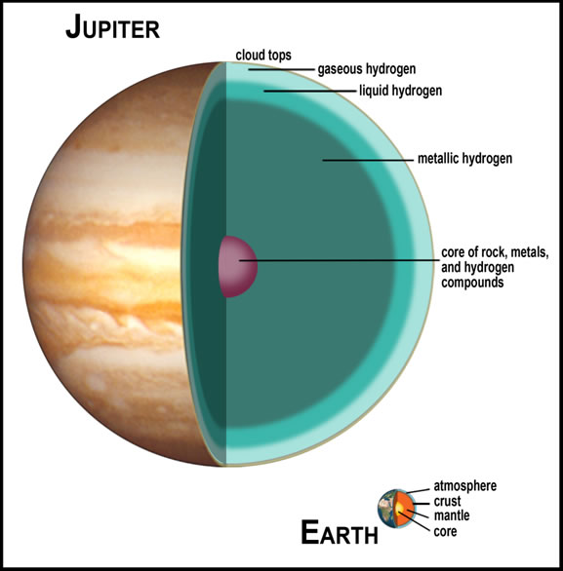
Planetary Structure
Notes:
Scientists aren't certain of just how solid Jupiter's core might be. While some theorize that the core is a hot molten ball of liquid, other research indicates that it could be a solid rock 12 to 18 times the mass of the Earth. The temperature at the core is estimated to be about 35,000 degrees Celsius (63,000 degrees Fahrenheit). Discussions about Jupiter's core didn't even begin until the late 1990s, when gravitational measurements revealed that the center of the gas giant was anywhere from 12 to 45 times the mass of Earth. And just because it had a core in the past doesn't mean that it still will today – new evidence suggests that the gas giant's core may be melting (?) (source wikipedia 2014).

Slide 13
Composition & Structure
Cloud bands move up to 240 mph
Different colors indicate different chemical make-up
Huge thunderstorms & hurricane-like features
Lightning is common
Notes:
The first color movie of Jupiter from NASA's Cassini spacecraft (flyby on the way to Saturn) shows what it would look like to peel the entire globe of Jupiter, stretch it out on a wall into the form of a rectangular map, and watch its atmosphere evolve with time. The brief movie clip spans 24 Jupiter rotations between Oct. 31 and Nov. 9, 2000. Various patterns of motion are apparent all across Jupiter at the cloud-top level seen here. The Great Red Spot shows its counterclockwise rotation, and the uneven distribution of its high haze is obvious. When scientists call Jupiter a gas giant, they aren't exaggerating. If you parachuted into Jupiter in hopes of hitting the ground, you would never find firm landing. The atmosphere of Jupiter is over 90 percent hydrogen. The remaining 10 percent is almost completely made up of helium, though there are small traces of other gases inside.

Slide 14
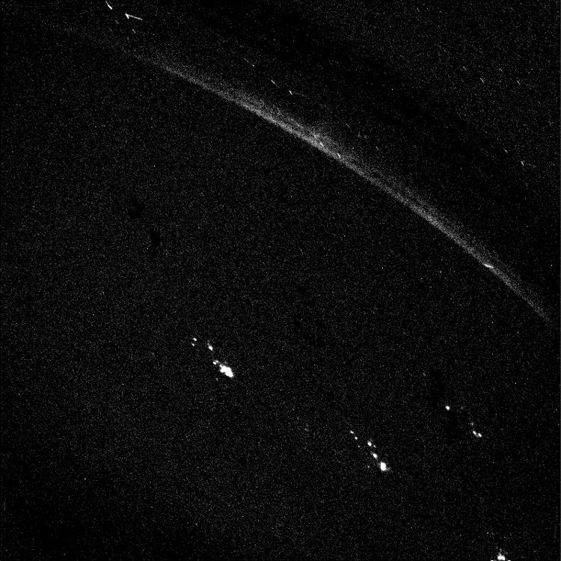
Lightning on Jupiter’s Night Side - Voyager 1
Notes:
Jupiter has powerful storms, always accompanied by lightning strikes. The storms are a result of moist convection in the atmosphere connected to the evaporation and condensation of water. They are sites of strong upward motion of the air, which leads to the formation of bright and dense clouds. The storms form mainly in belt regions. The lightning strikes on Jupiter are more powerful than those on Earth. White & brown ovals (as seen in the previous slide) are large storms with different intensities. Inside these ovals are where thunderclouds similar to Earth’s are found.

Slide 15
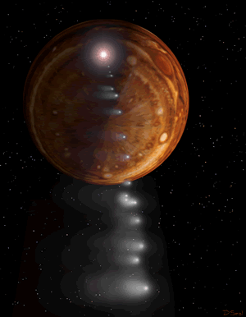
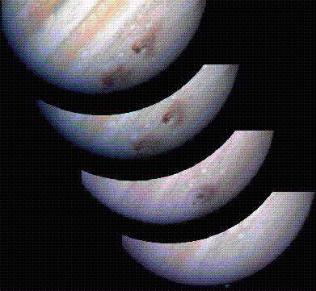
Comet Shoemaker-Levy 9 Impact (1994)
Video (1:10) “Jupiter Explosion: A Comet’s Tale”
Notes:
Astronomers have finally found direct proof that almost all water present in Jupiter's stratosphere, an intermediate atmospheric layer, was delivered by comet Shoemaker-Levy 9, which famously struck the planet in 1994. The findings, based on new data from the Herschel space observatory, reveal more water in Jupiter's southern hemisphere, where the impacts occurred, than in the north. Herschel is a European Space Agency mission with important NASA participation. (Artist rendition left illustration – HST images of Jupiter just after the string of impacts right image.)

Slide 16
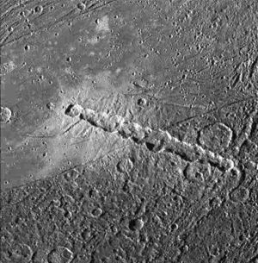
Jupiter’s Moon Ganymede’s Surface – String Cometary Impact
Notes:
View of a chain of craters named Enki Catena on Jupiter's moon, Ganymede. This chain of 13 craters probably formed by a comet which was pulled into pieces by Jupiter's gravity as it passed too close to the planet. Soon after this breakup, the 13 fragments crashed onto Ganymede in rapid succession.

Slide 17
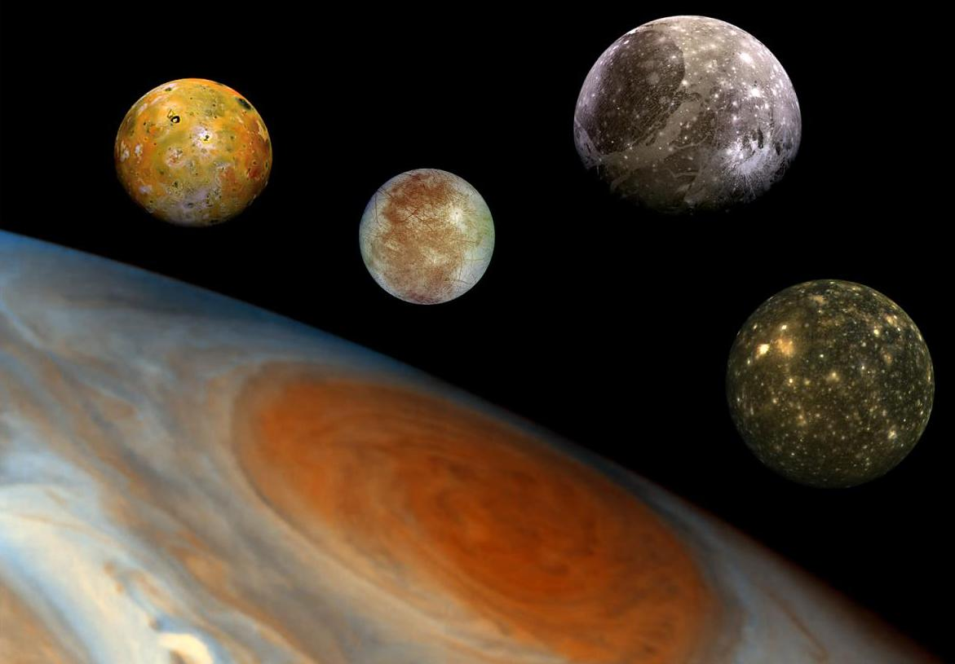
Moons
Four major moons – Io, Europa, Ganymede & Callisto
Each moon is about as large or larger than Earth’s single moon
All orbit Jupiter synchronously like Earth’s Moon
Notes:
These four largest and brightest moons of Jupiter, first discovered by Galileo Galilei in 1610, are known as the Galilean satellites. Starting from left to top right the moons are Io, Europa, Ganymede, and Callisto. This mosaic also shows the order of increasing distance from Jupiter (not to scale). All of the Galilean moons have very circular orbits around Jupiter (unlike Earth’s Moon). From the end of the 19th century, dozens of much smaller Jovian moons have been discovered and have received the names of lovers, conquests, or daughters of the Roman god Jupiter, or his Greek predecessor, Zeus.

Slide 18
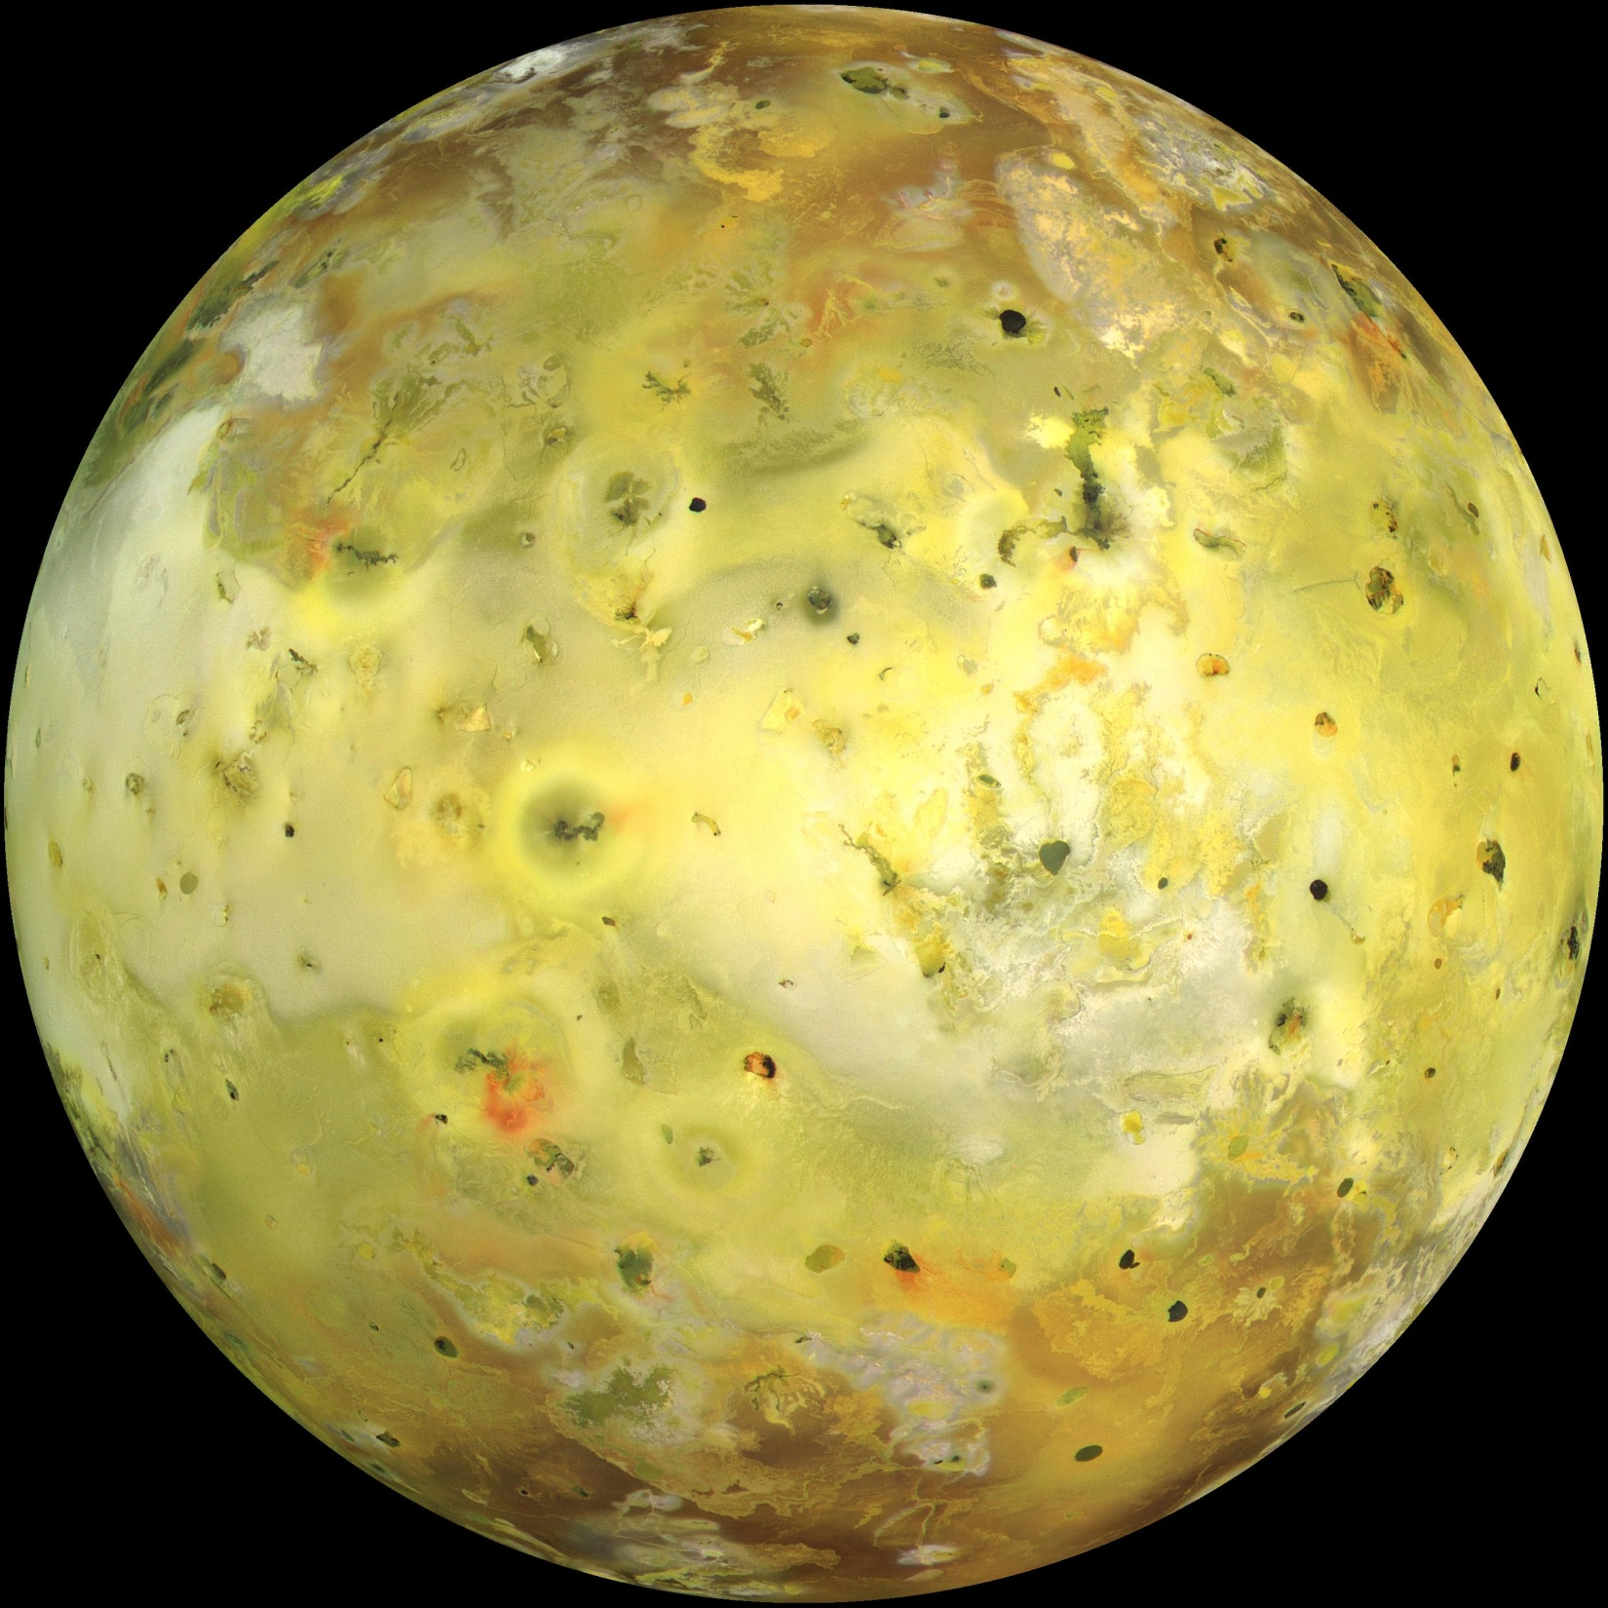
Moons
Io – (closest) known as the “pizza moon”
Most volcanically (known) active body in the solar system
Over 400 active volcanoes
Notes:
Io is the most volcanic body in the solar system, boasting activity 25 times that of Earth. Some of Io's volcanoes blast plumes of sulfur and other material 250 miles (400 kilometers) above the moon, which is completely resurfaced every million years or so. This intense activity is ultimately generated by gravitational tugs from Jupiter, with an assist from the nearby moons Europa and Ganymede. Venus is the only other solar system body that may have more active volcanoes – however direct observations of erupting Venusian volcanoes have not yet been found. Io is located about 262,000 miles (422,000 km) from Jupiter – which is just a little farther than the Earth-Moon distance (239,000 miles or 384,000 km). It takes Io about 1.8 Earth days to orbit Jupiter once – due to Jupiter’s much larger gravitational field (Earth’s Moon takes about 27.3 days for one orbit). It has recently been discovered (August, 2016) that Io’s very thin atmosphere of sulfur dioxide freezes and falls back to it’s surface for two hours (out of the 1.8 days) when it passes through Jupiter’s shadow – or when it is in eclipse. When Io passes out of the shadow & back into the sun’s light the sulfur dioxide ice sublimates back into a gas and the thin atmosphere returns.

Slide 19
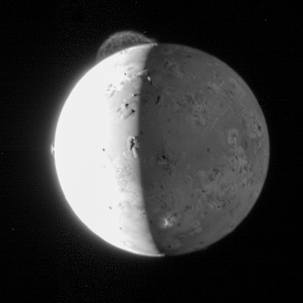
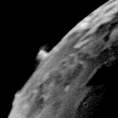
Moons
Io’s surface is constantly being recoated by volcanic eruptions
Volcanoes are caused by a continuous gravitational “tug of war” between Jupiter and Io’s outer sister moons
Notes:
Images and animations are from the Galileo spacecraft. Learning more about how Io's tidal heating works could shed light on the ability of other moons in the solar system to support life, researchers said. Tidal heating is thought to be the force making subsurface oceans of liquid water possible on frigid, ice-covered satellites, such as Europa (next slide) and Saturn's moon Enceladus (next lesson).

Slide 20
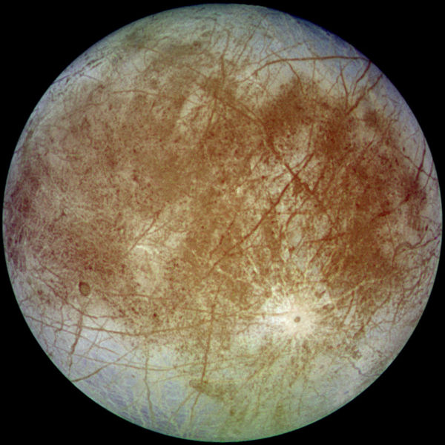
Moons
Europa – known as the “cue ball” moon
Extremely smooth surface; very little cratering
Lines are likely surface cracks
Notes:
This surface is striated by cracks and streaks, while cratering is relatively infrequent. Slightly smaller than Earth's Moon, Europa is primarily made of silicate rock and probably has an iron core. It has a tenuous atmosphere composed primarily of oxygen. Its surface is composed of water ice and is one of the smoothest in the Solar System. The Galileo mission, launched in 1989, provided the bulk of current data on Europa. Mean Distance from Jupiter 671,000 km (416,940 miles) Orbital Period around Jupiter3.551 Earth days.

Slide 21
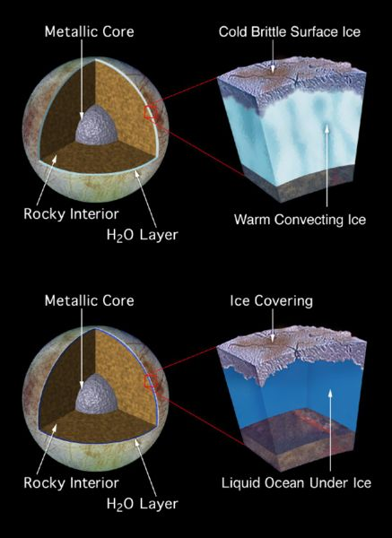
Moons
Europa’s surface has a 1-10 km thick crust of ice
Ice covers a large liquid-salty ocean
Ocean is probably heated internally by the gravity “tug-of-war”
Notes:
The apparent youth and smoothness of the surface have led to the hypothesis that a water ocean exists beneath it, which could conceivably serve as an abode for extraterrestrial life. This hypothesis proposes that heat energy from tidal flexing (gravity tug-of-war) causes the ocean to remain liquid and drives geological activity similar to plate tectonics here on Earth.

Slide 22
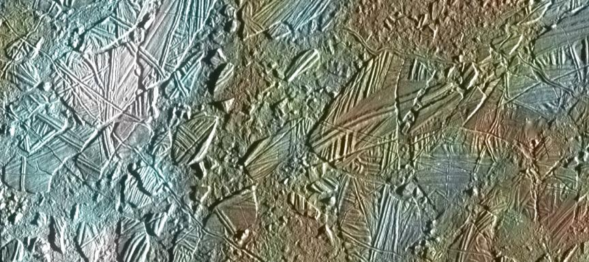
Europan Glaciers
Notes:
Enhanced-color view of part of Conamara Chaos, showing ice rafts up to 10 km (6 mi) across. White areas are water ice ejecta from the impact crater Pwyll.

Slide 23
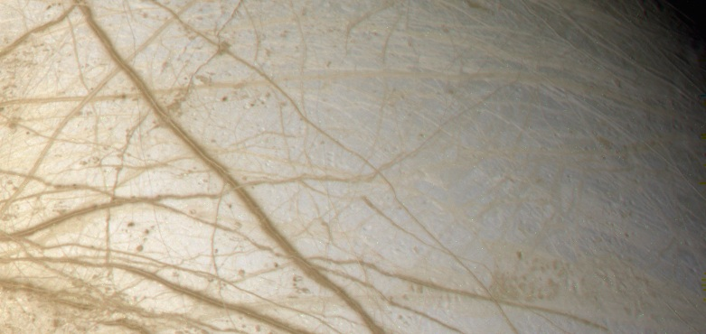
Europa’s Surface – True Color
Notes:
Approximately natural color image of Europa by the Galileo spacecraft, showing lineae. “Lineae” is Latin for line. In planetary geology it is used to refer to any long marking, dark or bright, on a planet or moon's surface. Streaks of reddish-brown color highlight cracks in Europa’s outer layer of ice. Some scientists have speculated that microorganisms suspended in Europa’s ice may be the cause of these colorations. - See more at: http://www.astrobio.net/news-exclusive/evidence-of-bacteria-on-europa/#sthash.I505y0qa.dpuf

Slide 24
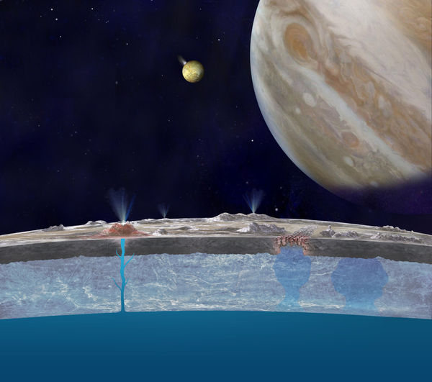
Cross-Section of Europa’s Crust & Sub-Surface Ocean
Notes:
Artist's concept, NASA/JPL-Caltech. A cross-section of Europa's crust and inner ocean. The Hubble Space Telescope has confirmed (Sept. 2016) that Europa has active water-ice plumes originating from a sub-surface ocean. This Jovian moon has an extensive ocean and possible undersea volcanoes. In the background is Jupiter & Europa’s sister moon IO (shown with an erupting volcano).

Slide 25
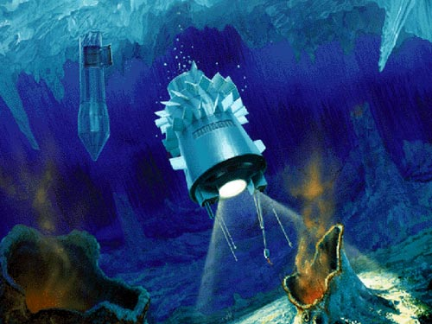
Possible Future Underwater Probe to Europa
Notes:
Artist rendition of a possible future robotic probe that may melt through Europa’s relatively thin ice crust to explore it’s oceans. Tidal heating most likely is the cause of Europa’s liquid oceans. Underwater hot-thermal vents here on earth have given rise to many communities of primitive and multi-cellular life. Europa most likely has thermal vents as well – and quite possibly life. A spacecraft mission to fly through Europa’s water plumes to sample the ocean chemistry may eliminate the need to drill through the icy surface.

Slide 26
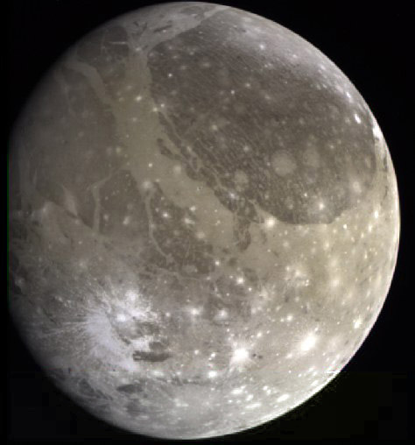
Moons
Ganymede – largest moon in the solar system - larger than the planet Mercury
Craters, ridges, valleys & a possible small ocean may exist under or near its icy/rocky surface
Notes:
Ganymede is the largest satellite in our solar system. It is larger than Mercury and Pluto, and three-quarters the size of Mars. If Ganymede orbited the sun instead of orbiting Jupiter, it would easily be classified as a planet. Mean Distance from Jupiter1,070,000 km (664,867 miles) Orbital Period around Jupiter 7.155 Earth days.

Slide 27
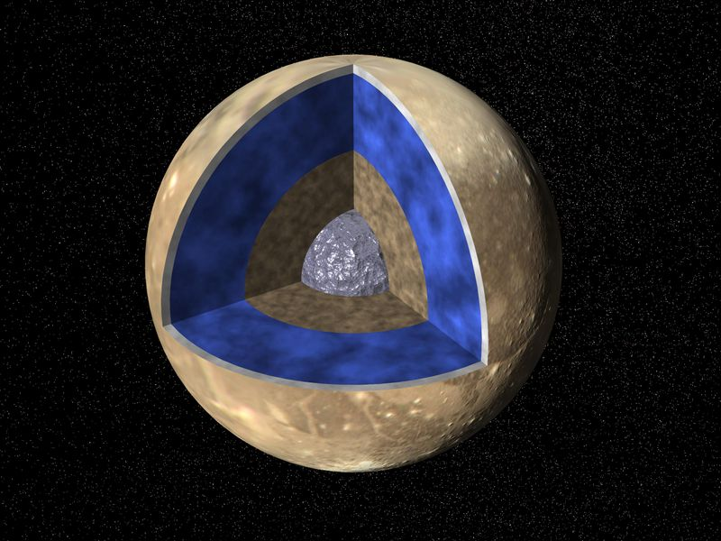
Ganymede’s Internal Structure –Magnetic Field Detected
Notes:
Ganymede has three main layers. A sphere of metallic iron at the center (the core, which generates a magnetic field), a spherical shell of rock (mantle) surrounding the core, and a spherical shell of mostly ice surrounding the rock shell and the core. The ice shell on the outside is very thick, maybe 800 km (497 miles) thick. The surface is the very top of the ice shell. Spacecraft images of Ganymede show the moon has a complex geologic history.

Slide 28
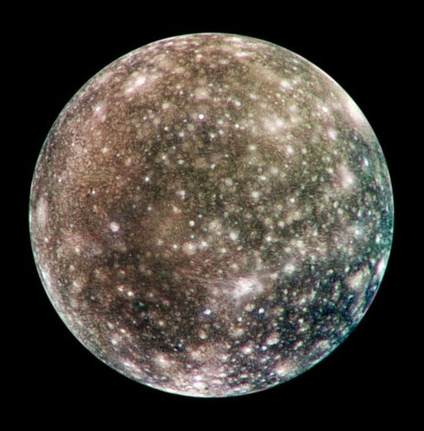
Moons
Callisto – (outer most) ancient heavily cratered icy/rocky surface about 200 km thick
An ocean may also exist under the crust
Valhalla - largest multi-ring impact basin in the Solar System
Notes:
Jupiter’s moon Callisto is the most heavily cratered object in the solar system. It also has the oldest landscape. It is thought to be a long dead world, with hardly any geologic activity on its surface. The likely presence of an ocean within Callisto still leaves open the possibility that it could sustain life. Because of its low radiation levels, Callisto has long been considered the suitable place among the Galilean moons for future exploration. Valhalla is the largest multi-ring basin on Callisto and in the Solar System (with diameter up to 3,800 km). Asgard is the second largest multi-ring structure (impact crater) measuring 1600 km in diameter. It is named after Asgard, the realm of the gods in Norse mythology. Mean Distance from Jupiter 1,883,000 km (1,170,042 miles). Orbital Period around Jupiter16.689 Earth days.

Slide 29
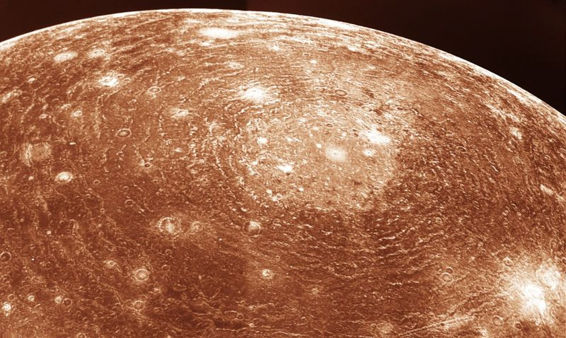
Valhalla Impact Basin - Callisto
Notes:
Voyager 1 image of Jupiter's moon Callisto from a distance of 350,000 km. The large ‘bulls-eye’ at the top is believed to be an impact basin formed early in Callisto's history. The bright center of the basin is about 600 km across and the outer ring is about 2,600 km across. The heat from the impact temporarily melted the icy/rocky surface which quickly refroze – preserving the ripples of this ancient impact basin.

Slide 30
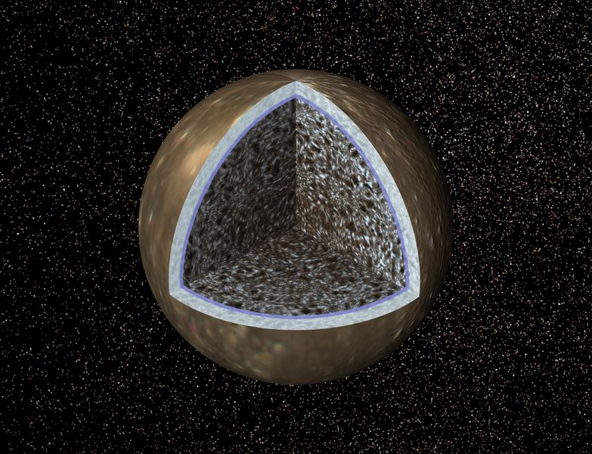
Callisto - Compressed Rock Under Ice & Water – No Core (?)
Notes:
Callisto is the outermost of the Galilean moons. Because of its orbiting distance from Jupiter (about 1,168,000 miles) it takes about seventeen Earth days to make one complete orbit of the planet. No magnetic field usually means no active or spinning core. Callisto is roughly the same size as Mercury. It is the third largest moon in the entire solar system. It has the lowest density of the four Galilean moons.

Slide 31
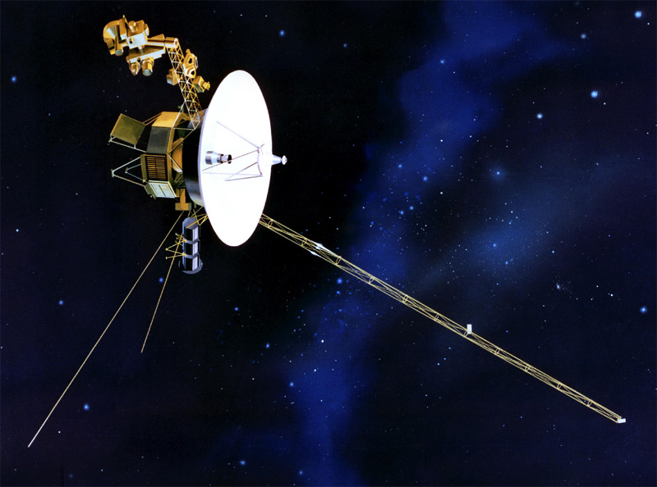
Missions
“Flyby’s” : Pioneer 1 & 2 (1970’s); Voyagers 1 & 2 (1979)
Ulysses (1992); Cassini (2000); New Horizons (2007)
Each took pictures & gathered data
Notes:
Artist rendition of the Voyager spacecraft – which are still operating and nearing the “edge” of the solar system. Both Pioneer & Voyagers have headed out of the solar system. After launch, Ulysses headed out to Jupiter, arriving in February 1992 for the gravity-assist manuever that swung the craft into its unique polar solar orbit – to study the Sun from above the ecliptic (mission ended in 2009). Cassini is still orbiting Saturn (as of 2014). New Horizons flew by Pluto in July of 2015. By using Jupiter’s gravity a spacecraft can receive a major boost in speed and a change in direction in what is known as a “gravity assist.”

Slide 32
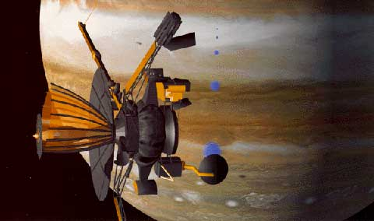
Missions
Galileo (1995) orbited Jupiter for 8 years
Intentionally crashed into Jupiter to gather more atmospheric data
Notes:
Galileo was launched in 1989, and it circled Jupiter 34 times. Over the years, its discoveries were extraordinary. NASA also decided to crash the Galileo spacecraft (running out of fuel to maneuver) into Jupiter to make sure it didn't collide with Europa and scatter any possible Earth microbes over it.

Slide 33
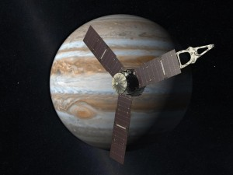
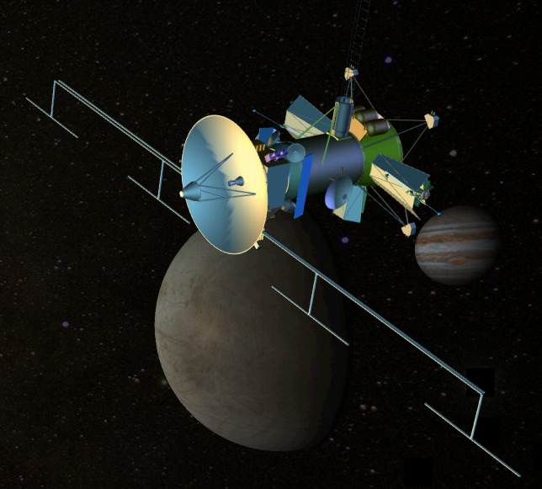
Missions
Current mission is the spacecraft Juno (Jupiter Polar Orbiter) which arrived in 2016
Video (3:20) “What Lies Inside Jupiter?”
Europa Clipper – mission currently planned to determine if Europa may have conditions for life
Notes:
Juno will, for the first time, see below Jupiter's dense cover of clouds when it arrives in 2016. This is why the mission was named after the Roman goddess, who was Jupiter's wife, and who could also see through clouds. The Juno spacecraft will orbit Jupiter 33 times, skimming to within 3,100 miles (5,000 kilometers) above the planet's cloud tops every 11 days, for approximately one year. Europa Clipper is a concept under study by NASA that would conduct detailed reconnaissance of Jupiter's moon Europa and would investigate whether the icy moon could harbor conditions suitable for life. The mission would perform a detailed investigation of Europa using a highly capable, radiation-tolerant spacecraft that would perform repeated close flybys of the icy moon from a long, looping orbit around Jupiter. As of 2014 funding for the mission looks very promising as the U.S. Congress will vote to provide NASA with the additional funds required to conduct the mission. As of August 2016 – full funding of this mission has been approved. Tentative launch date: 2025.

Slide 34
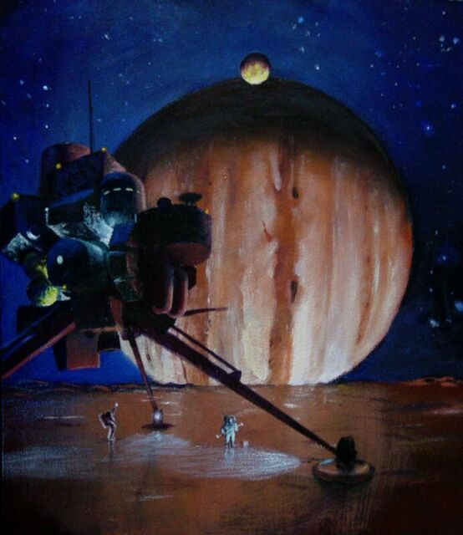
Europa – Eventual Human Exploration?
Notes:
The colonization of Europa presents numerous difficulties. One is the high level of radiation from Jupiter's radiation belt, which is about 10 times as strong as Earth's Van Allen radiation belts. As Europa receives 540 rem of radiation per day (500 rem is a fatal dose), a human would not survive at or near the surface of Europa for long without significant radiation shielding. Colonists on Europa would have to descend beneath the surface when Europa is not protected by Jupiter's magneto tail, and stay in subsurface habitats. This would allow colonists to use Europa's ice sheet to shield themselves from radiation.

Slide 35
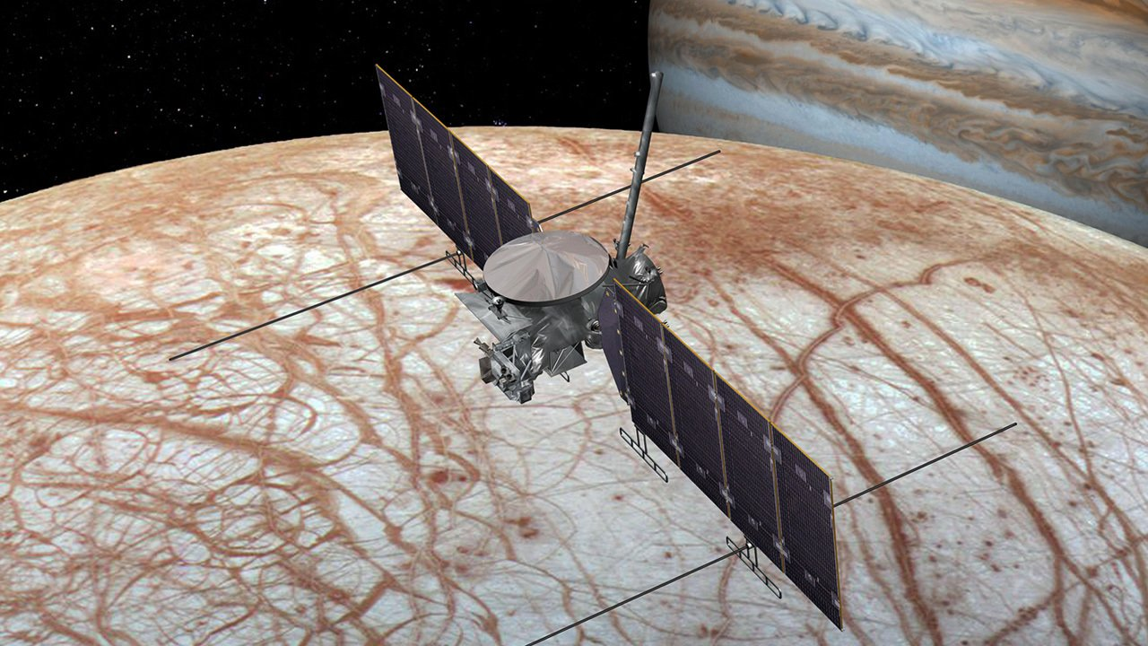
NASA’s Europa Clipper – Launch Date 2022 - 2025
Notes:
Artist rendition of the Europa Clipper. In the grand tradition of these classic “clipper” ships, the Europa Clipper spacecraft would sail past Europa at a rapid cadence, as frequently as every two weeks, providing many opportunities to investigate the moon up close. The prime mission plan includes 40 to 45 flybys, during which the spacecraft would image the moon's icy surface at high resolution and investigate its composition and the structure of its interior and icy shell. The mission will also (most likely) probe Europa’s icy geysers for the chemical composition of its oceans and whether it is conducive for life. For more information on this mission visit https://www.nasa.gov/europa

Slide 36
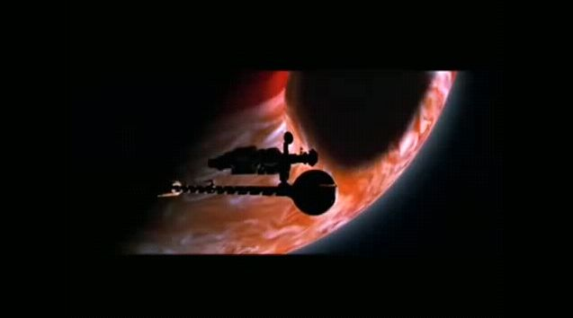
Class Assignment
Movie Clip “2010: Odyssey II”
Review this lesson at Kahoot.it!
Notes:
The clip shows the ending of the 1984 sequel to the 1968 science fiction classic “2001: A Space Odyssey.” Astronauts barely escape a “terraformed” Jupiter as it explodes into a red dwarf star. An alien message is then sent to the astronauts not to land on Europa. The following scenes showing two suns from Earth are basically scientifically accurate if Jupiter somehow became a star. Possible questions: describe the conditions on Earth if Jupiter became second sun. Why did the aliens warn the crew not to land on Europa? This lesson can be reviewed with a 20-question quiz at https://play.kahoot.it/#/?quizId=f8a0dd65-b3ce-4553-b6e5-8a1b33446e2d - or click on the link above in presentation mode.

Slide 37
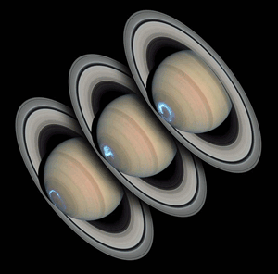
Next Up – Saturn
Notes:
1998 HST (Hubble Space Telescope) image of Saturn’s southern auroae.

