Slide 1
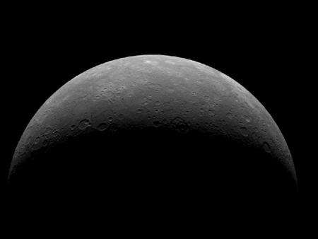
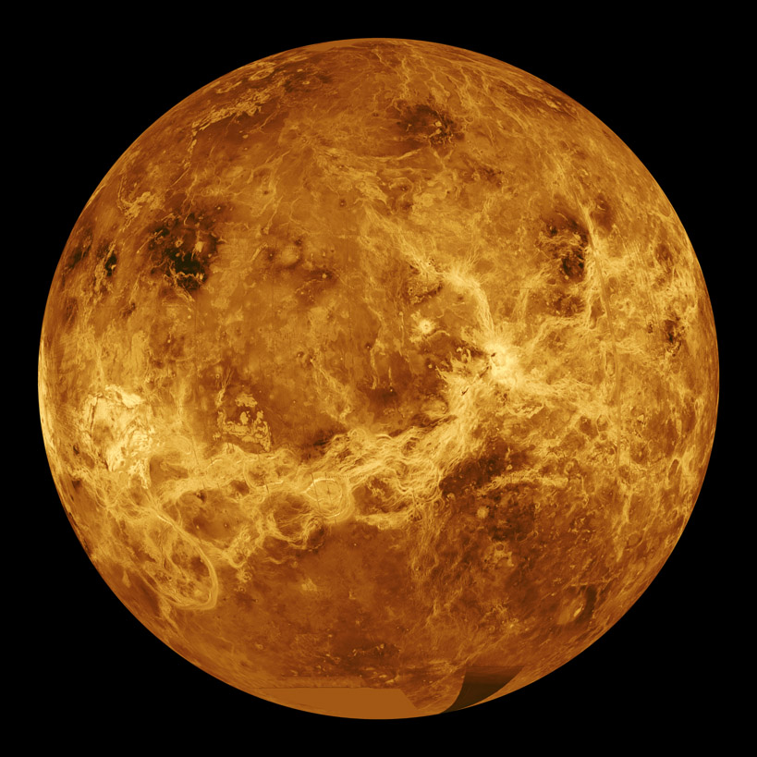
Notes Unit IV-I “Mercury and Venus”
Astronomy
Notes:
Picture on the left is of Mercury taken by the MESSENGER spacecraft that orbited from 2012 - 2015. Image on the right is from the space craft Magellan which shows the surface of Venus through radar mapping done by NASA in 1991.

Slide 2
S.W.B.A.T
Identify physical characteristics of Mercury & Venus
Understand how the two inner planets compare
Discuss the evolutionary history of both planets
Notes:
“Students Will be Able To…” (another way to state the lesson objectives).

Slide 3
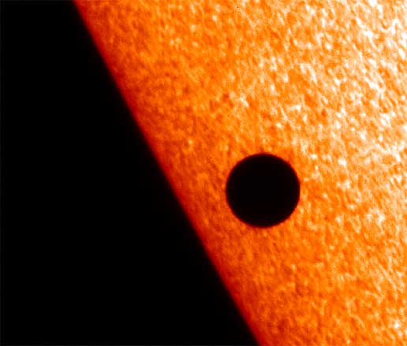
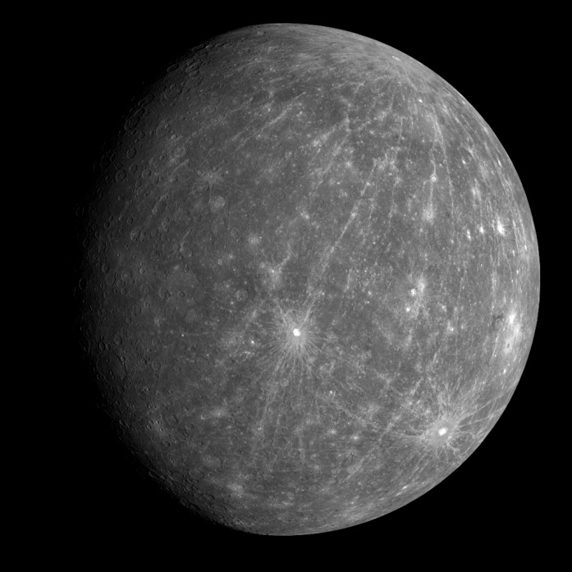
Planet Mercury
Smallest, closest & fastest planet to orbit the Sun
Heavily cratered surface that resembles the Moon
Notes:
Top image shows Mercury transiting the Sun as seen from the Earth. Transits of Mercury with respect to Earth are much more frequent than transits of Venus, with about 13 or 14 per century, in part because Mercury is closer to the Sun and orbits it more rapidly. Transits of Mercury occur in May or November. The last three transits occurred in 1999, 2003 and 2006; and in 2016. The next will occur on Nov. 11th, 2019 – after that not again until 2032. Part of the difficulty in sending a spacecraft to Mercury is that the probe has to reach speeds up to 65,000 mph to reach the planet. Bottom image is from the spacecraft MESSENGER which has imaged over 96% of Mercury’s surface. MESSENGER spacecraft used the last of its maneuvering propellant and deorbited as planned, impacting the surface of Mercury on April 30, 2015.

Slide 4
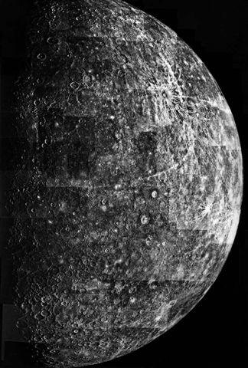
Planet Mercury
Average distance from the Sun .39 AU or 58 million kilometers (36 million miles)
2440 km in radius or about .38 (less than half) the size of Earth
Notes:
Picture is a mosaic from many flyby’s of the Mariner 10 spacecraft in 1974. Mariner 10 was the first spacecraft sent to study Mercury. Mariner 10 also studied Venus while using the planet's gravity to modify its speed and trajectory (“gravitational assist”), enabling it to reach Mercury.

Slide 5
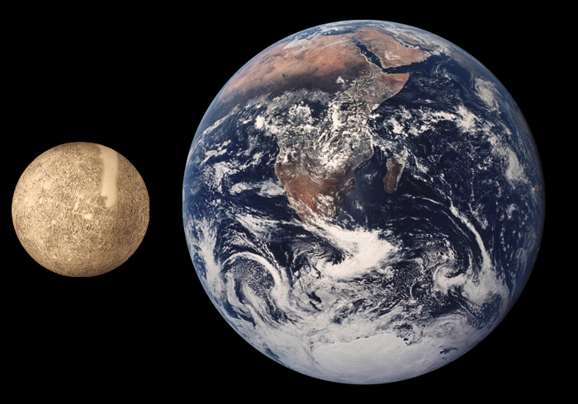
Mercury & Earth to Scale (note “smooth” area on Mercury are missing data from Mariner 10)
Notes:
Mariner 10 was the only mission to Mercury until NASA's MESSENGER mission more than 30 years later. It was also the first spacecraft to reach one planet by using the gravity of another planet (in this case, Venus) to alter its speed and trajectory. Gravity assists has become an extremely important technique in saving fuel (and money) to get unmanned spacecraft to their destinations (this will be discussed in further detail in the next unit – “The Outer Planets.”)

Slide 6
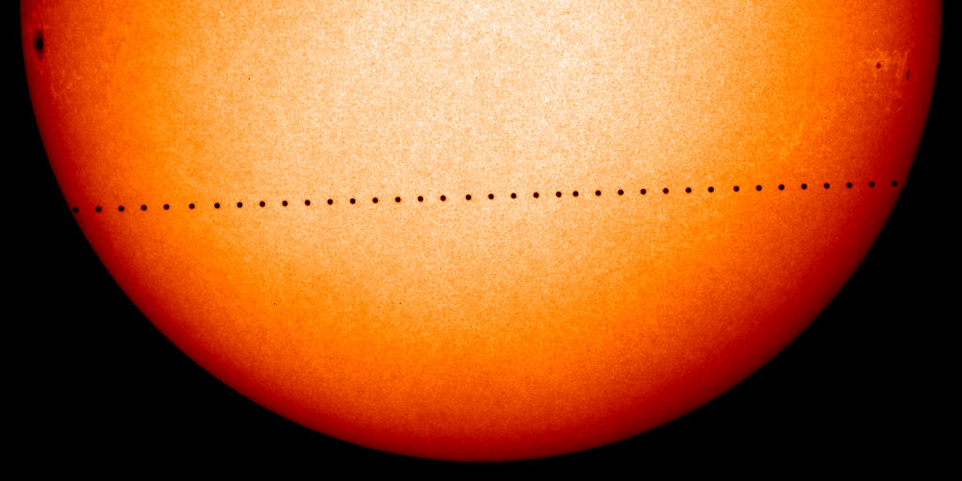
Planet Mercury
Orbits the Sun in 88 days
Spins once on its axis every 59 days (sidereal period)
Surface temperature ranges from -300ºF to +800ºF (over 1000º difference)
Notes:
Picture shows a time-lapse image of Mercury transiting the Sun as seen from earth. Astronomers were able to observe planet transits at different points on Earth to eventually calculate planet size and distances. Surface temperature difference is between daytime and night. Mercury is the closest planet to the sun. As such, it circles the Sun faster than all the other planets, which is why Romans named it after the swift-footed messenger god Mercury.

Slide 7
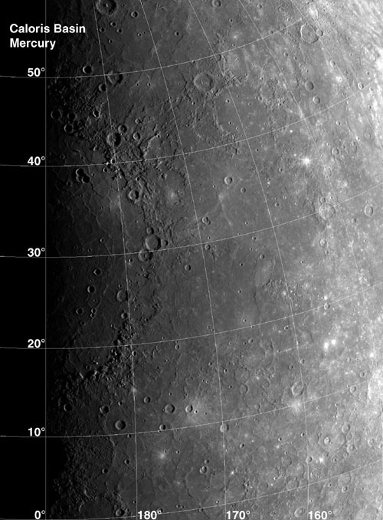
Planet Mercury
Only inner planet besides Earth to have a measurable magnetic field
Inner iron core (nucleus) is very large
Iron core spins creating an electric/magnetic field effect like Earth
Notes:
A completely unexpected discovery Mariner 10 made was that Mercury possessed a magnetic field. Planets theoretically generate magnetic fields only if they spin quickly and possess a molten core. But Mercury takes 59 days to rotate and is so small — just roughly one-third Earth's size — that its core should have cooled off long ago. The recent discovery from 2007 Earth-based radar observations that Mercury's core may still be molten could help explain its magnetism.

Slide 8
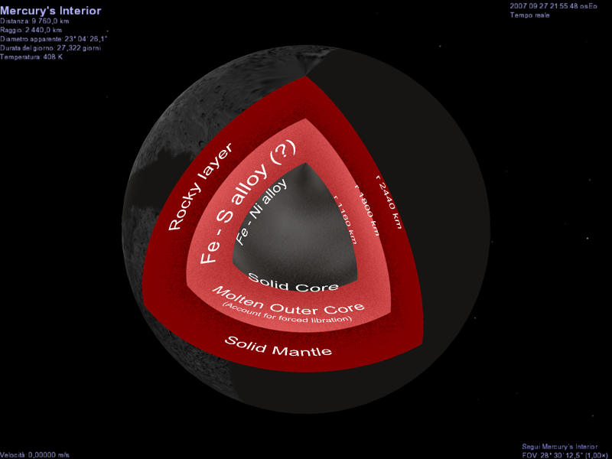
Notes:
Astronomers only learned recently that Mercury’s core is liquid, and not solid (as shown in the diagram above) as originally theorized. They did this by studying how radio signals bounce off the surface of Mercury. They found that wobbles in the planet’s rotation matched predictions only if Mercury’s core was liquid. Surrounding the core of Mercury is the mantle. Similar to Earth, this mantle consists of silicates, but it only measures 500-700 km thick. Compared this to the Earth’s mantle, which accounts for most of the volume of the planet. And surrounding Mercury’s mantle is its crust. A region of the planet the measures between 100-300 km thick. Unlike the Earth’s crust, Mercury’s crust has no plate tectonics, so it doesn’t have plates that float above the interior of Mercury.

Slide 9
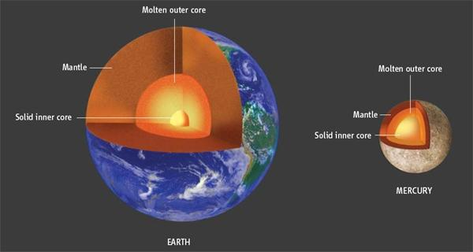
Earth’s Internal Structure Compared With
Mercury
Notes:
The interior of Mercury is remarkably similar to the interior of our own planet Earth. Like Earth, Mercury has a crust, mantle and core. At the heart of Mercury is it’s core. This is a ball of liquid iron and other metals that measures approximately 3,600 km across. Considering the fact that Mercury itself is only 4,879 km across, the planet’s core accounts for 42% of its volume. Compare this to the Earth’s core, which only accounts for 17% of our planet’s volume.

Slide 10
Mercury’s Magnetic Field
Notes:
Mercury's magnetic field is approximately a magnetic dipole (meaning the field has only two magnetic poles) that is significant, and apparently global. Although Mercury's magnetic field is just 1 percent the strength of Earth's, it is very active. The magnetic field in the solar wind — the charged particles streaming off the sun — periodically touches upon Mercury's field, creating powerful magnetic tornadoes that channel the fast, hot plasma of the solar wind down to the planet's surface.

Slide 11
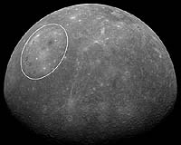
Planet Mercury
Caloris Basin – very large impact structure near the equator created about 4 billion years ago
One of the largest impact basins in the Solar System
Notes:
The Caloris Basin is the largest feature on the surface of Mercury. This crater was formed by the impact of a large meteorite in the early formation of the solar system. This major impact feature is just north of the planet's equator and is surrounded by circular mountain ridges up to 2 km (6500 ft) high. The diameter of the basin is 1300 km (810 mi).

Slide 12
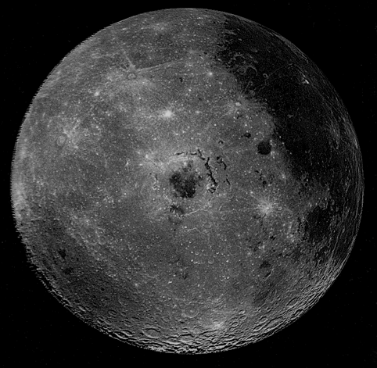
Caloris Basin
Notes:
Caloris is Latin for heat and the basin is so-named because the Sun is almost directly overhead every second time Mercury passes perihelion (closest point in orbit to the Sun). The impact basin is one of the largest in the solar system. Similar impact basins on the Moon such as the Mare Imbrium and Mare Orientale are believed to have formed at about the same time, possibly indicating that there was a 'spike' of large impacts towards the end of the heavy bombardment phase of the early solar system (about 4 billion years ago). Based on MESSENGER's photographs, Caloris' age has been determined to be between 3.8 and 3.9 billion years.

Slide 13
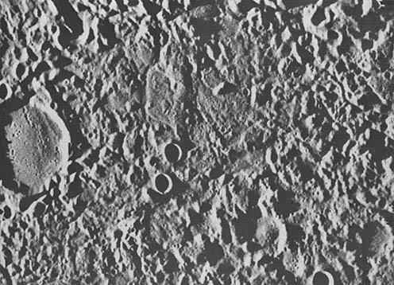
Planet Mercury
The impact created “weird terrain” on the other side of Mercury (ex.’s mountains, scarps & cliffs)
Because of Mercury’s small size it cooled quickly also helping to form the “weird” crustal terrain
Notes:
Image is from the MESSENGER spacecraft. But, “weird” just isn’t a very scientific sounding name, so it is officially called the “Hilly” and “ Lineated Terrain.” Sometimes, it is called the “Chaotic Terrain,” because it looks pretty chaotic. Computer simulations suggest that the ground on the far side of the planet may be displaced upward from hundreds of meters up to perhaps a kilometer within minutes. This would break the terrain into large chunks, giving such a chaotic appearance.

Slide 14
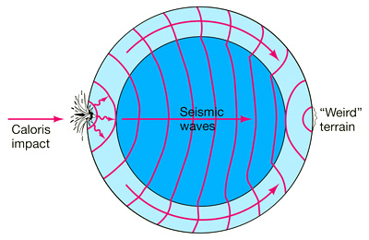
Notes:
At the antipode of the Caloris Basin lies a large region of unusual, hilly and furrowed terrain, sometimes called “Weird Terrain”. The favored hypothesis for the origin of this geomorphologic unit is that shock waves generated during the impact traveled around the planet, and when they converged at the basin’s antipode (180 degrees away) the high stresses were capable of fracturing the surface.

Slide 15
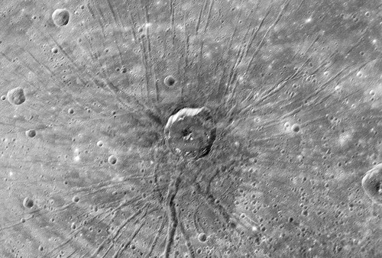
The “Spider” Impact Basin
Notes:
This formation never has been seen on Mercury before and nothing like it has been observed on the moon. It lies in the middle of the huge impact crater - the Caloris basin - and consists of more than 100 narrow, flat-floored troughs radiating from a complex central region.

Slide 16
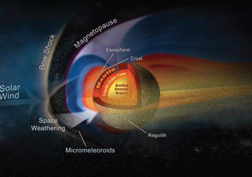
Planet Mercury
Very dense metallic/rock crust composition
Small axial tilt (3º)
Highly eccentric orbit (.206 compared to Earth’s .016)
No moons & no (real) atmosphere
Video (1:26) “Planet Mercury Facts”
Notes:
Mercury is the second-densest planet behind Earth. However – if Mercury was closer in size to Earth it would be more dense. Of all the planets in the solar system, Mercury has the thinnest atmosphere, thinner than even Mars. Several components are constantly replenished by the solar wind blowing off of the nearby Sun. Its low surface gravity makes holding on to an atmosphere in the best of circumstances a challenge. Essentially, Mercury isn’t considered to have an actual atmosphere like the other three terrestrial planets.

Slide 17
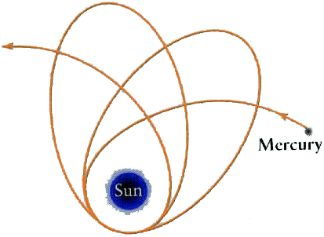
Mercury’s Eccentric Orbit May One Day Boost it Out of the Solar System
Notes:
Mercury's orbit is very eccentric (non-circular). A perfect circle has an eccentricity of 0 and a parabola 1. Mercury's eccentricity is 0.2, the highest of all the planets. The huge gravitational pull of Jupiter seems to be bullying Mercury into an increasingly eccentric death-orbit, possibly flinging the cosmic lightweight (millions of years from now) into the path of Venus.

Slide 18
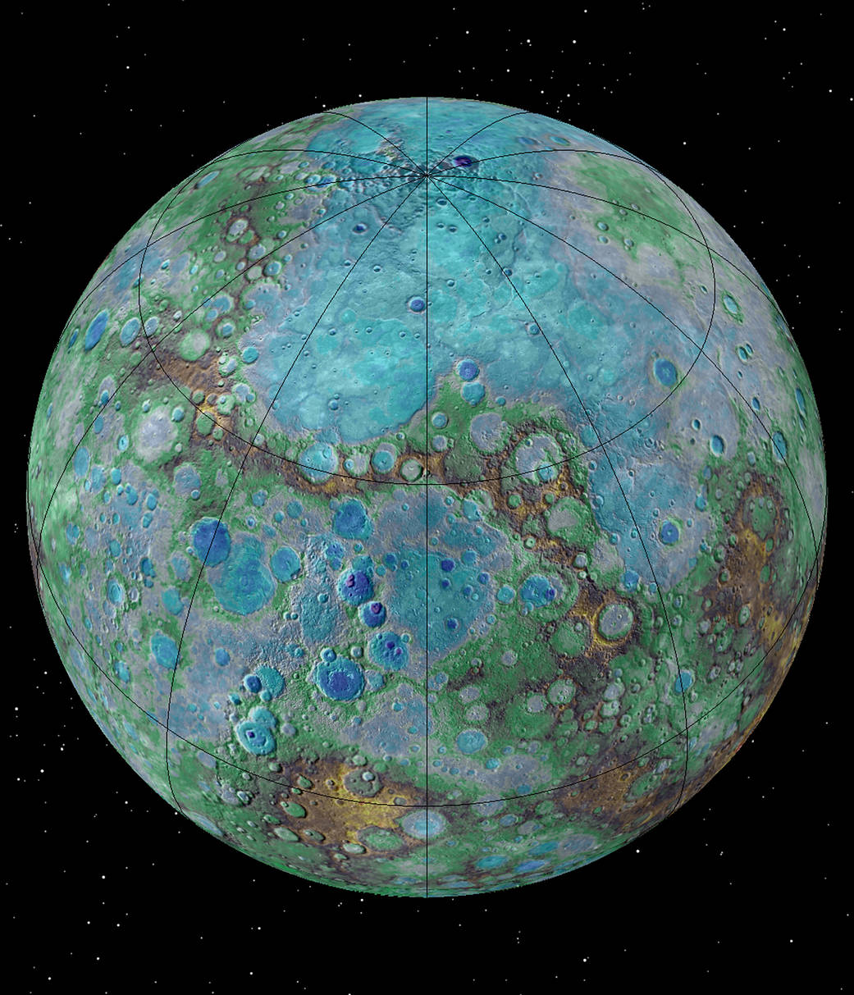
Latest Topographic Map of Mercury’s Shrinking Surface – Tectonically Active?
Notes:
It’s small, it’s hot, and it’s shrinking. New NASA-funded research suggests that Mercury is contracting even today, joining Earth as a tectonically active planet.
Images obtained by NASA’s MErcury Surface, Space ENvironment, GEochemistry, and Ranging (MESSENGER) spacecraft reveal previously undetected small fault scarps— cliff-like landforms that resemble stair steps. These scarps are small enough that scientists believe they must be geologically young, which means Mercury is still contracting and that Earth is not the only tectonically active planet in our solar system, as previously thought. The highest elevation on Mercury (in white, red, yellow & brown) is at 2.78 miles (4.48 kilometers) above Mercury’s average elevation, located just south of the equator in some of Mercury’s oldest terrain. The lowest elevation (blue, dark blue & purple), at 3.34 miles (5.38 kilometers) below Mercury’s average, is found on the floor of Rachmaninoff basin, an intriguing double-ring impact basin suspected to host some of the most recent volcanic deposits on the planet.

Slide 19
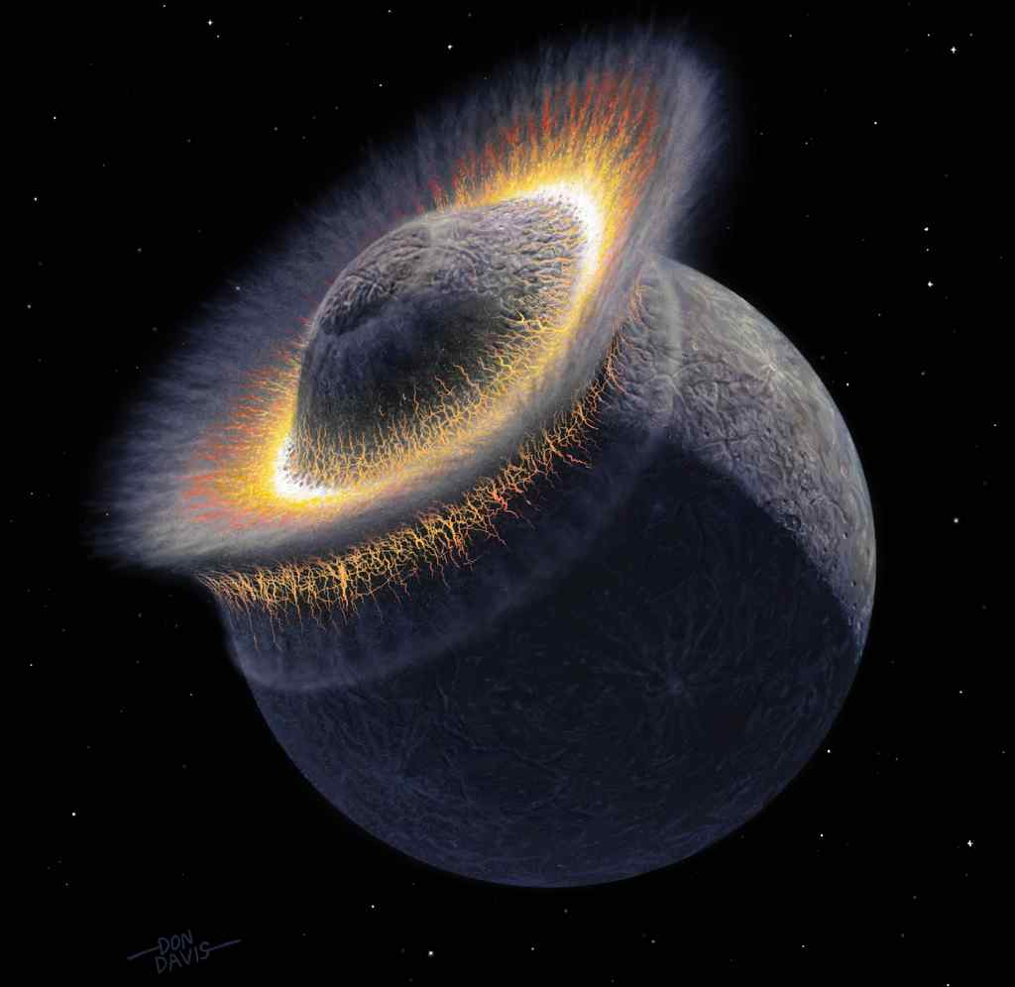
Planet Mercury
Mercury may have been struck by a large planetesimal early in its history stripping away mantle material
This may explain why the core is so large
Notes:
For its small size, this planet contains a large amount of iron. No one really knows (yet) how this large iron core could have formed. Many scientists think that when Mercury was in its early stages of formation, it crashed into another planet whose core contained a large amount of iron.

Slide 20
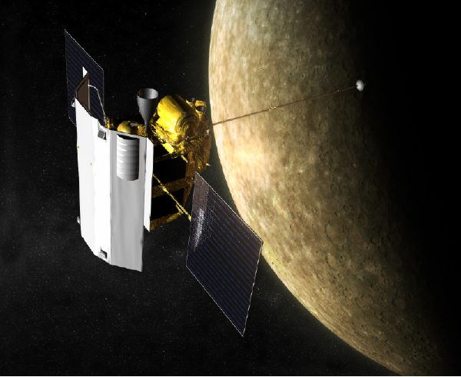
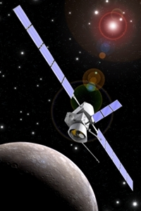
MESSENGER Spacecraft 2007 – 2015 & Europe’s BeppiColombo Mission 2024
Video Animation (:43) “Messenger’s Journey To Mercury”
Notes:
Since moving into orbit about Mercury in 2007, NASA's MESSENGER spacecraft has captured nearly 100,000 images and returned data that have revealed new information about the planet, including its topography, the structure of its core, and areas of permanent shadow at the poles that host the mysterious polar ice deposits. Before running out of fuel, MESSENGER was intentionally crashed into Mercury’s surface to gather more data in April, 2015. BepiColombo is Europe's first mission to Mercury. It will set off in 2018 on a journey to the smallest and least explored terrestrial planet in our Solar System (arrival in 2024).

Slide 21
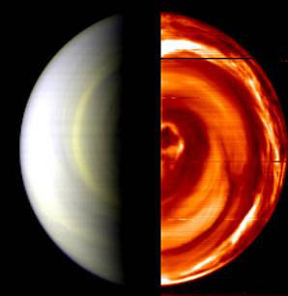
Planet Venus
.72 AU or 109 million km from the Sun
Closest (on average) & brightest planet as seen from Earth
6000 km in radius or about .95 size of the Earth
Notes:
Image reveals Venus’ swirling atmospheric turbulence (right) as measured in the infrared region of light – compared with the visible portion (left – from the ESA’s Venus Express Orbiter 2012). Venus is the planet which is closest to the Earth and is a little smaller than the Earth. The diameter of the Earth (the distance right round the middle of the Earth at the equator) is 12,760 km, or 7926 miles. The diameter of Venus is 12,103 km, or 7520 miles.

Slide 22
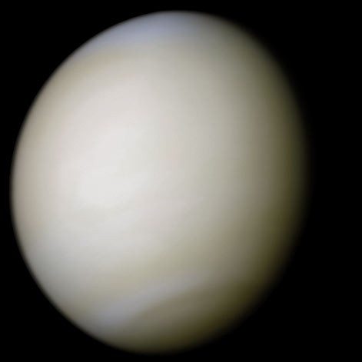
Venus Up-Close (Actual Color)
Notes:
Thick clouds have obscured the planets surface since telescopes were first aimed at Venus. The clouds also reflect a large amount of sunlight – giving Venus the title of the third-brightest object in the sky behind the Moon & Sun. Venus remained shrouded in mystery until the Space Age because the clouds hide its surface from view. Early planetary scientists envisioned a lush world of oceans, constant rains, and abundant life. Yet the reality is far different: Venus is incredibly hot, dry, and totally unsuitable for life (as we know it).

Slide 23
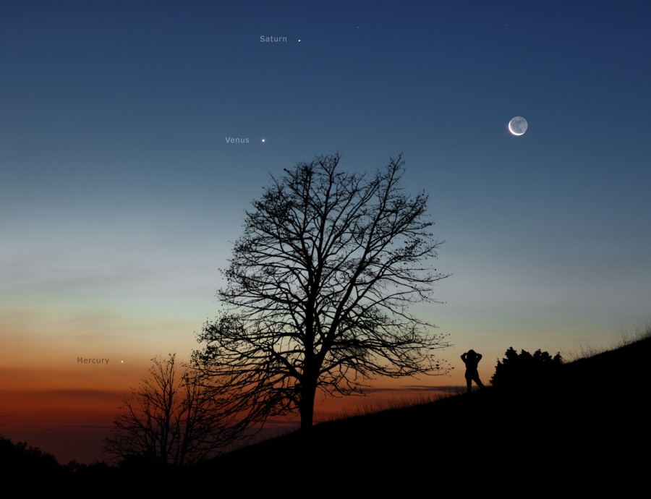
Notes:
Real photograph showing three planets - Mercury, Venus & Saturn with a crescent Moon on the right at sunset.

Slide 24
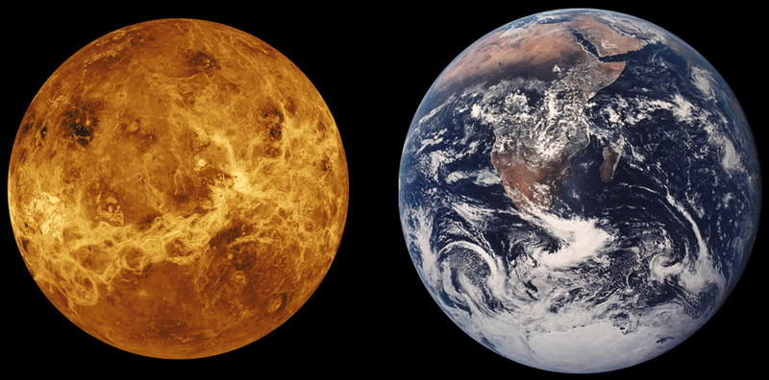
Earth’s “Twin” (In Size Only)
Notes:
Venus minus the clouds (radar image of its surface) as compared to Earth – to scale. Despite the similarity in size Venus & Earth are very different.

Slide 25
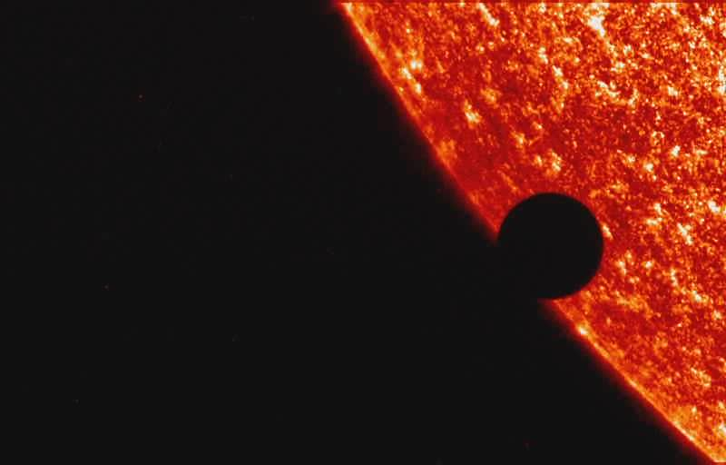
Planet Venus
One year = 225 Earth days
One Venusian day = 243 Earth days
A Venusian day is longer than its year!
Notes:
The Venusian clouds kept astronomers from seeing the planet's surface. Without visible landmarks, they could not measure how fast Venus turns on its axis – until the 1960’s when powerful radar beamed from Earth was able to “see” beneath the clouds.

Slide 26
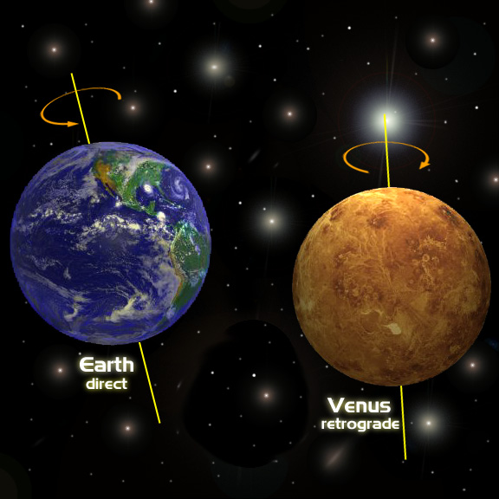
Planet Venus
Rotates opposite or retrograde from all the other planets (east to west)
Most tilted planet – 177.4º from the solar plane
Tilt may be due to a collision later in formation
Notes:
It took cloud-penetrating radar, first aimed at Venus in the early 1960s, for scientists to discover that Venus rotates backward as compared to the other planets in the solar system. This means that the Sun rises in the west and sets in the east. And Venus' rotation is extremely slow, so the length of a "day" on Venus is longer than a year. The planet's "retrograde" rotation could be the result of a collision between Venus and a large proto-planet billions of years ago, when the solar system was forming.

Slide 27
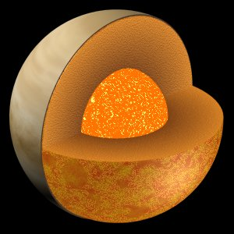
Planet Venus
Internal structure resembles Earth – core, mantle, crust
Venus was unable to cool down and remains hotter internally than Earth
Notes:
The interior of Venus is probably similar to Earth's interior. Venus, like Earth, is one of the terrestrial planets and is made of rock and metal. It probably has a partly molten metallic core, a rocky mantle, and a crust.

Slide 28
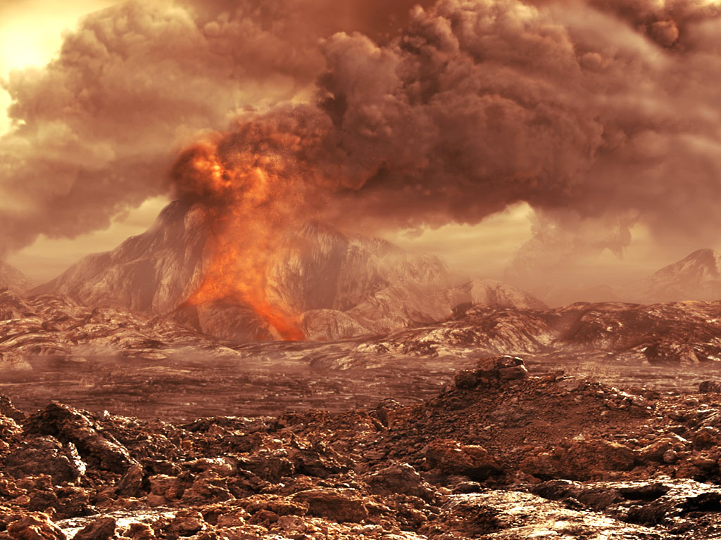
Planet Venus
Planet resurfaces itself roughly every 500 million years with fresh lava flows
Lack of eroded impact craters may indicate active volcanism
Notes:
Artist rendition of the Venusian surface. One possible explanation for the resurfacing event is that it is part of a cyclic process on Venus. On Earth, plate tectonics allows heat to escape from the mantle. However, Venus has no evidence of plate tectonics, so this theory states that the interior of the planet heats up (due to the decay of radioactive elements) until material in the mantle is hot enough to force its way to the surface. The subsequent resurfacing event covers most or all of the planet with lava, until the mantle is cool enough for the process to start over.

Slide 29
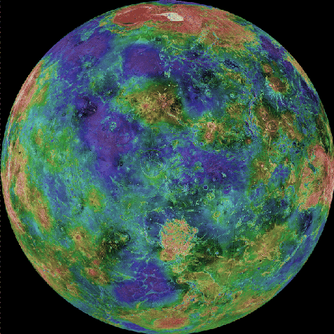
Planet Venus
Currently no plate tectonics; no oceans (way too hot) or magnetic field
Surface is relatively young (500 million years old)
Notes:
The surface of Venus is dominated by volcanism. Although Venus is superficially similar to Earth, it seems that the tectonic plates so active in Earth's geology do not exist on Venus. About 80% of the planet consists of a mosaic of volcanic lava plains, dotted with more than a hundred large isolated shield volcanoes, and many hundreds of smaller volcanoes and volcanic constructs such as coronae (oval-shaped features). These are geological features believed to be almost unique to Venus: huge, ring-shaped structures 100–300 km (60–180 mi) across and rising hundreds of meters above the surface.

Slide 30
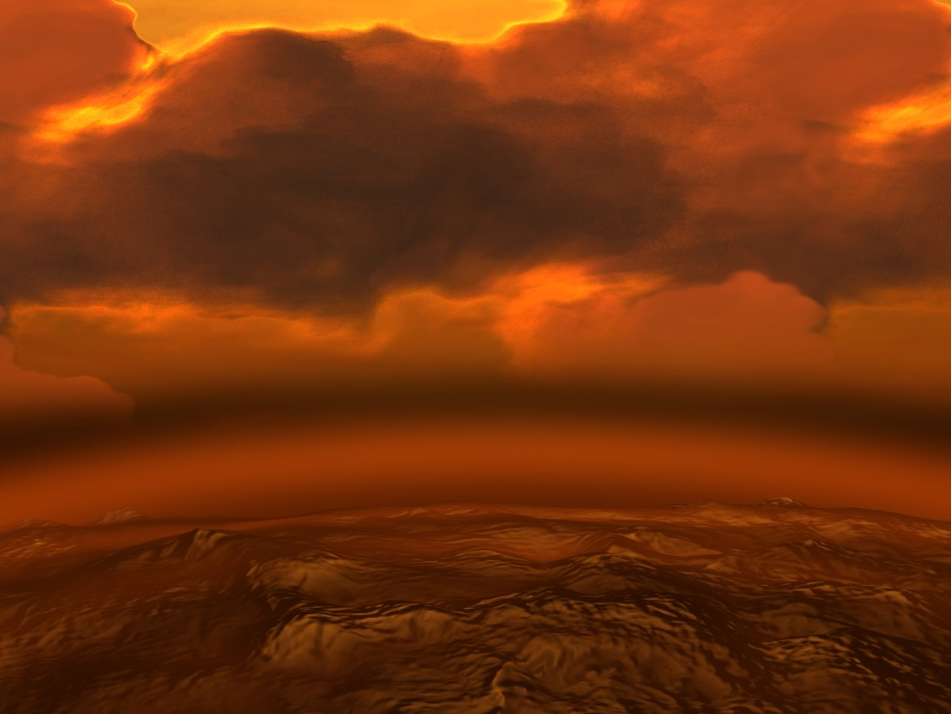
Planet Venus
Thick atmosphere of CO₂ – 100 times thicker than Earth’s
“Runaway” greenhouse effect – trapping the Sun’s heat at the surface
Causes temperatures to be over 900ºF – hotter than Mercury
Notes:
(Artist impression.) The atmosphere of Venus is composed of about 96% carbon dioxide, with most of the remainder being nitrogen. The atmosphere appears to be relatively clear until the cloud deck starts about 50 km above the surface. The clouds are composed of sulfuric acid and various other corrosive compounds, and the atmosphere contains little water. The greenhouse effect occurs for all planetary atmospheres containing greenhouse gases, and is responsible for their being warmer than would be the case otherwise. The greenhouse effect by itself could not account for the conditions that we find on Venus. However, under certain conditions scientists believe the greenhouse effect can "run away". For example, Earth has enormous amounts of two greenhouse gases: water vapor and carbon dioxide. However, for the Earth most of the water and carbon dioxide are not in the atmosphere. The water is mostly in the oceans, and the carbon dioxide is mostly bound chemically in rocks made from compounds that chemists call carbonates (for example, limestone).

Slide 31
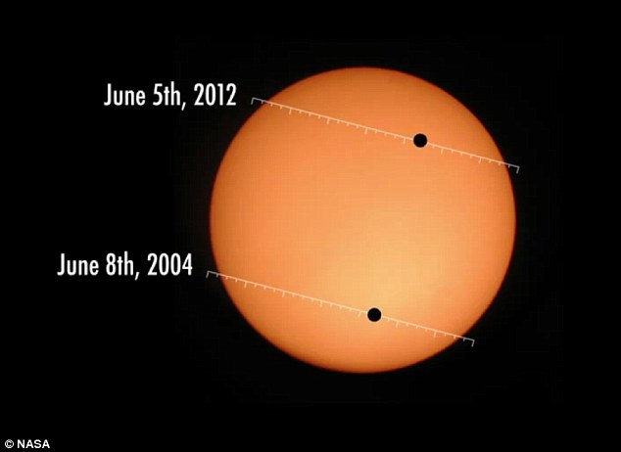
Planet Venus
Almost circular orbit - .008 eccentricity
No moons
Magellan spacecraft (1989) radar mapped over 160 volcanoes & 1000 craters on the surface
Notes:
Magellan created the first (and currently the best) near-photographic quality, high resolution radar mapping of the planet's surface features. Prior Venus missions had created low resolution radar globes of general, continent-sized formations. Magellan, however, finally allowed detailed imaging and analysis of craters, hills, ridges, and other geologic formations, to a degree comparable to the visible-light photographic mapping of other planets. Magellan's global radar map will remain the most detailed Venus map in existence for the foreseeable future, although the planned Russian Venera-D may carry a radar that can achieve the same, if not better resolution as the radar used by Magellan.

Slide 32
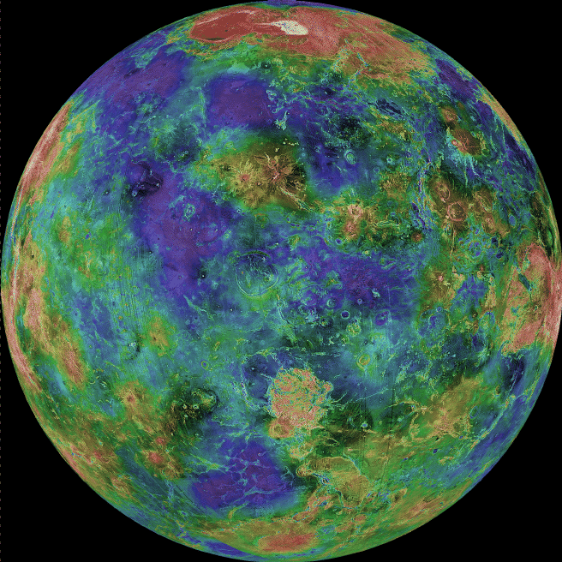
Magellan Spacecraft Radar Map of Venus (“blue” - low elevations; “red” - high elevations)
Notes:
Magellan was a space probe made almost completely out of spare parts from other spacecraft. It carried a radar and radio antenna. Magellan was launched from the space shuttle Atlantis on May 4, 1989, becoming the first probe launched from a space shuttle. Magellan’s mission was to create a detailed map of at least 70% of Venus’ surface. It did this by bouncing radar waves off of the planet. It could tell if there were mountains and what the surface was made out of by how fast the radar came back. After it gathered information, the probe sent it back to Earth by the radar antenna. Magellan’s mission was a great success - it mapped 98% of Venus’ surface!

Slide 33
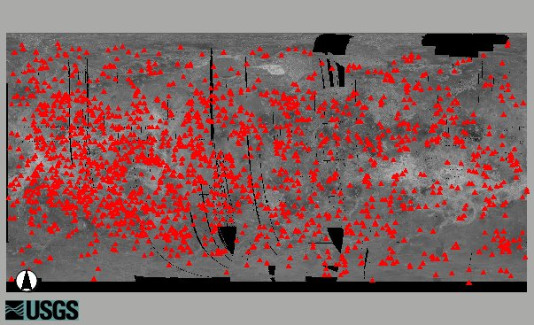
Venus’ Volcanoes (Active?)
Notes:
The last six years of observations by Venus Express have shown a marked rise and fall of the levels of sulfur dioxide (SO₂) in Venus’ atmosphere, similar to what was seen by NASA’s Pioneer Venus mission from 1978 to 1992. These spikes in SO₂ concentrations could be the result of volcanoes on the planet’s surface, proving that the planet is indeed volcanically active — but then again, they could also be due to variations in Venus’ complex circulation patterns which are governed by its rapid “super-rotating” atmosphere.

Slide 34
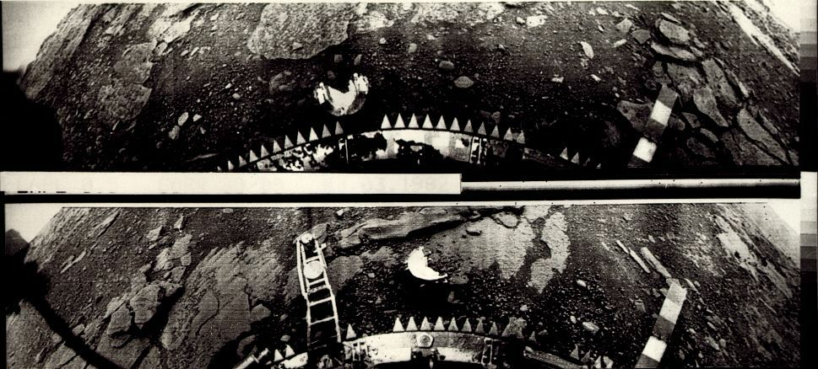
Planet Venus
Veneras (1970’s) spacecraft landed on the surface
Detected lightning, thunder & returned a few pictures of the surface
Notes:
Surface photographs from the Soviet Venera 14 spacecraft. The Venera 14 lander became the second Venus surface probe to transmit color images after setting down on 5 May 1982 (these photos are obviously not in color – but are from the same mission).

Slide 35
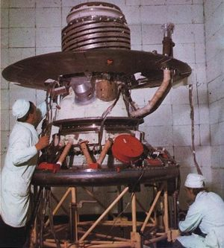
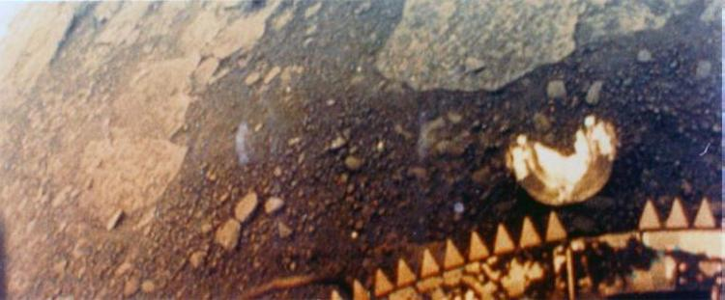
Russia’s Venera 11
Notes:
Venera 13, a Soviet/Russian spacecraft, was the first lander to transmit color images from the surface of Venus (right). Although other landers arrived before and after it, pictures from Venera 13 tend to be more widely circulated because they are in color. The spacecraft was designed to last about half an hour on Venus' harsh surface, but sent back data for more than two hours after its landing March 1, 1982. Since no lander has ventured on to Venus since the 1980s, the Venera program's images of the surface stand as the best close-up record of the planet today.

Slide 36
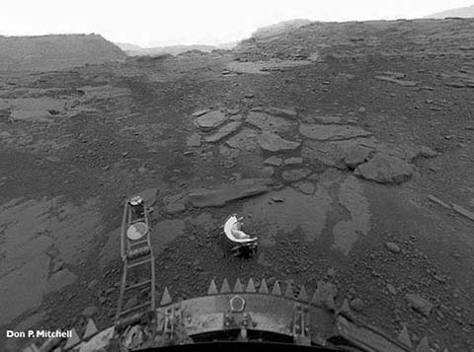
Surface of Venus – Venera 11
Notes:
Venera 11 was part of a two-spacecraft Russian mission to study Venus and the interplanetary medium. Each of the two spacecraft, Venera 11 and Venera 12, consisted of a flight platform and a lander probe. Identical instruments were carried on both spacecraft. In the foreground is a piece of metal from the lander. The incredible atmospheric pressure and heat caused the landers to deteriorate rapidly after landing – usually completely destroyed after 30 minutes on the Venusian surface.

Slide 37
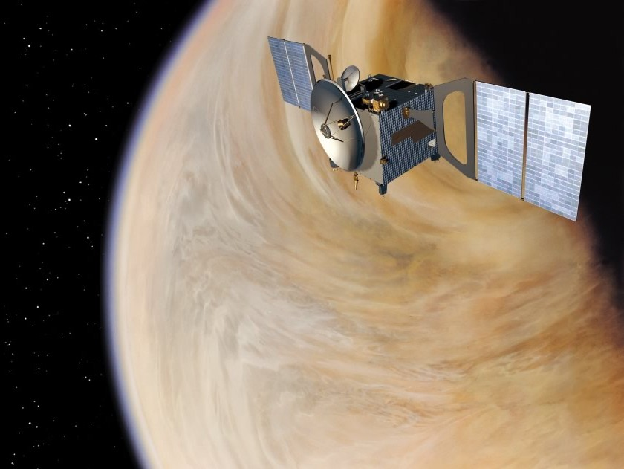
Planet Venus
Venus Express (2006 - ?) currently orbiting the planet
Discovered huge polar vortexes of unknown origin in the atmosphere
Video (5:00) “Atmosphere & Weather on Venus”
Notes:
Venus Express (VEX) is the first Venus exploration mission of the European Space Agency. Launched in November 2005, it arrived at Venus in April 2006 and has been continuously sending back science data from its polar orbit around Venus. Equipped with seven scientific instruments, the main objective of the mission is the long term observation of the Venusian atmosphere. The observation over such long periods of time has never been done in previous missions to Venus, and is key to a better understanding of the atmospheric dynamics. It is hoped that such studies can contribute to an understanding of atmospheric dynamics in general, while also contributing to an understanding of climate change on Earth. The ESA concluded the mission in December 2014.

Slide 38
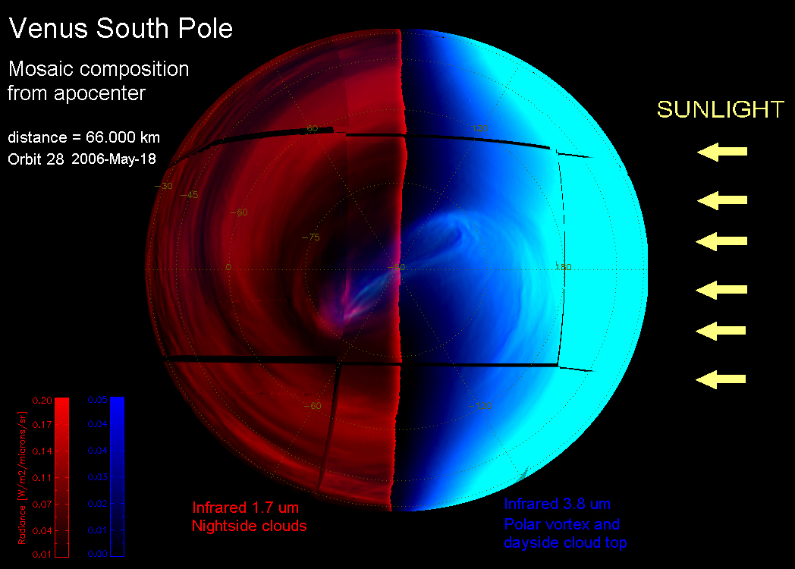
South Polar Vortex
Notes:
A detailed study of Venus' South Polar Vortex (through the ESA’s Venus Express Orbiter or VEX) shows a much more chaotic and unpredictable cyclone than previously thought. The analysis reveals that the center of rotation of the vortex wanders around the pole differently at different altitude levels in the clouds of Venus. In its stroll around the Pole, in layers separated by 20 km, the vortex experiences unpredictable changes in its morphology.

Slide 39
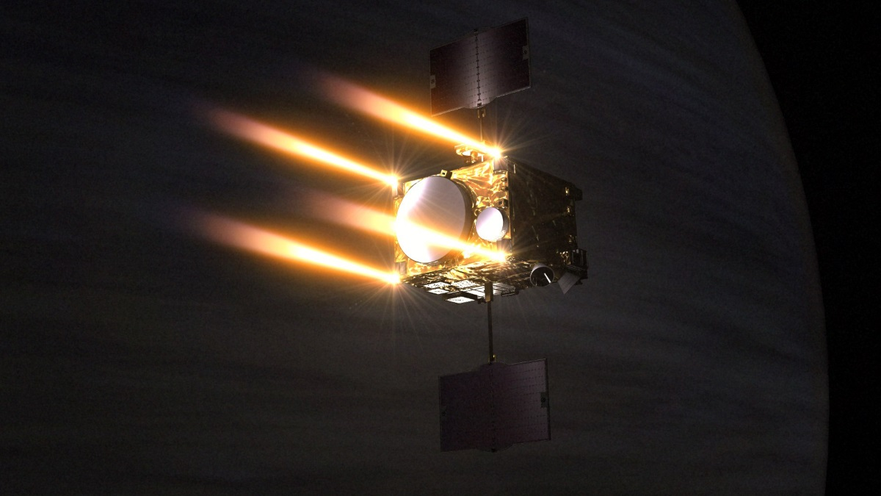
Classwork Assignment
Read Ch. 8 p. 198 – 226 (Planet Mercury)
Answer Review & Discussion Questions # 2, 4, 6, 9, 13 & 19 p. 226
Review this lesson at Kahoot.it!
Notes:
Artist rendition of the Akatsuki ("Dawn") spaceprobe, also known as the Venus Climate Orbiter (VCO) and Planet-C. It is a Japanese (JAXA) space probe tasked to study the atmosphere of Venus. It was launched aboard an H-IIA 202 rocket on 20 May 2010, and failed to enter orbit around Venus on 6 December 2010. After the craft orbited the Sun for five years, engineers placed it into an alternative successful elliptical Venusian orbit on 7 December 2015 by firing its attitude control thrusters for 20 minutes. By using five different cameras, Akatsuki will study the stratification of the atmosphere, atmospheric dynamics, and cloud physics. This lesson can be reviewed with a 20-question interactive quiz at https://play.kahoot.it/#/?quizId=ee1f9f19-6ae3-4a9d-b7cc-78fa026b192d - or click the link above in presentation mode.

